Slide 1
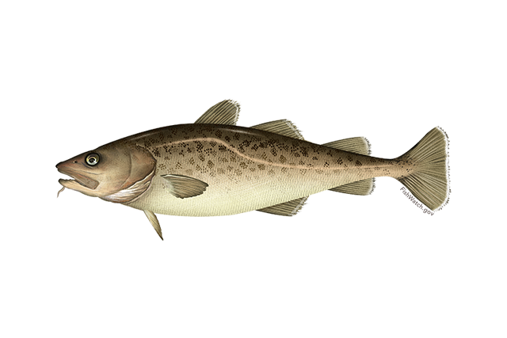

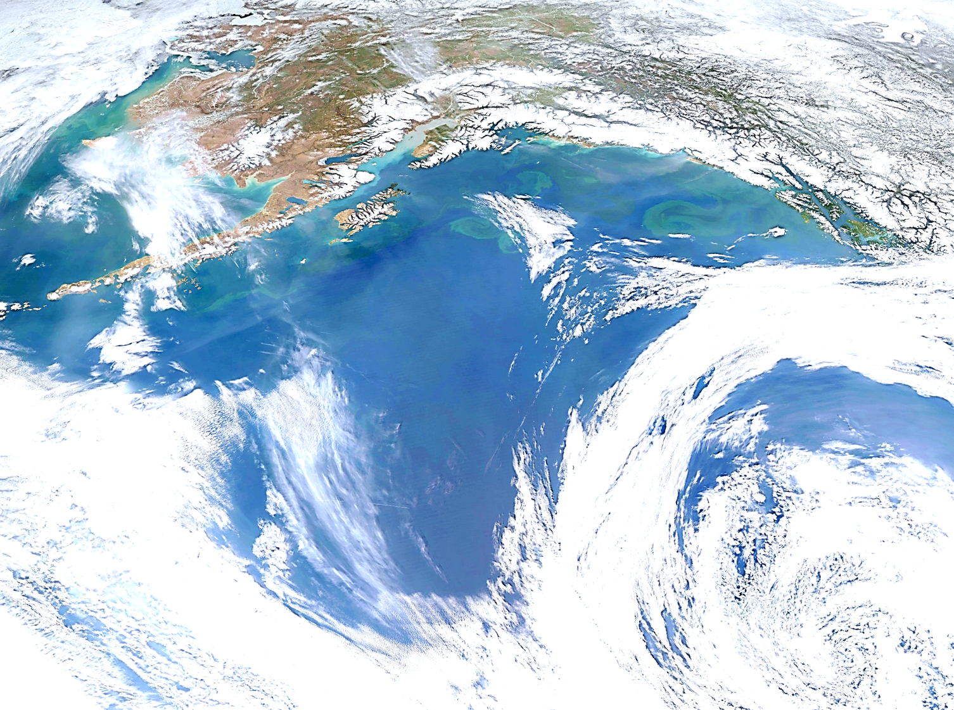
Goa pacific cod
Pete hulson, steve barbeaux, bridget ferriss, Susanne mcdermott, and Ingrid spies – november 2022

Slide 2
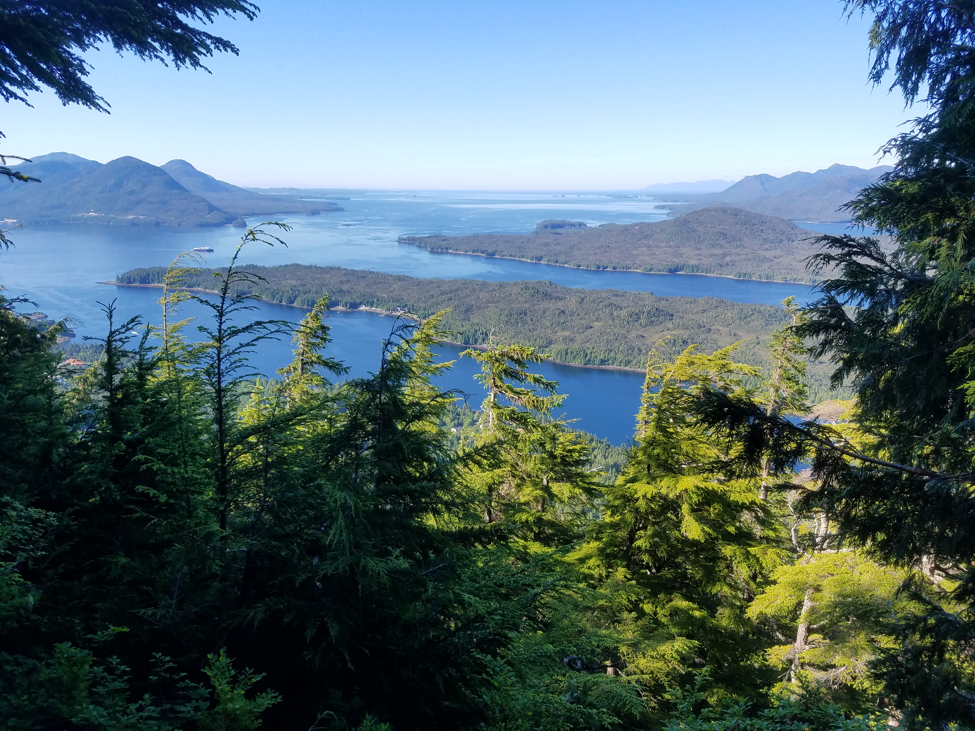
Stock overview
GOA Pacific cod: Tier 3b
2023 projected spawning biomass to be at B_{25.5%}
No changes to model. Updated data since 2022, added state catch from 1997 – 2002
PT/SSC comments not addressed this year (so not included)

Slide 3
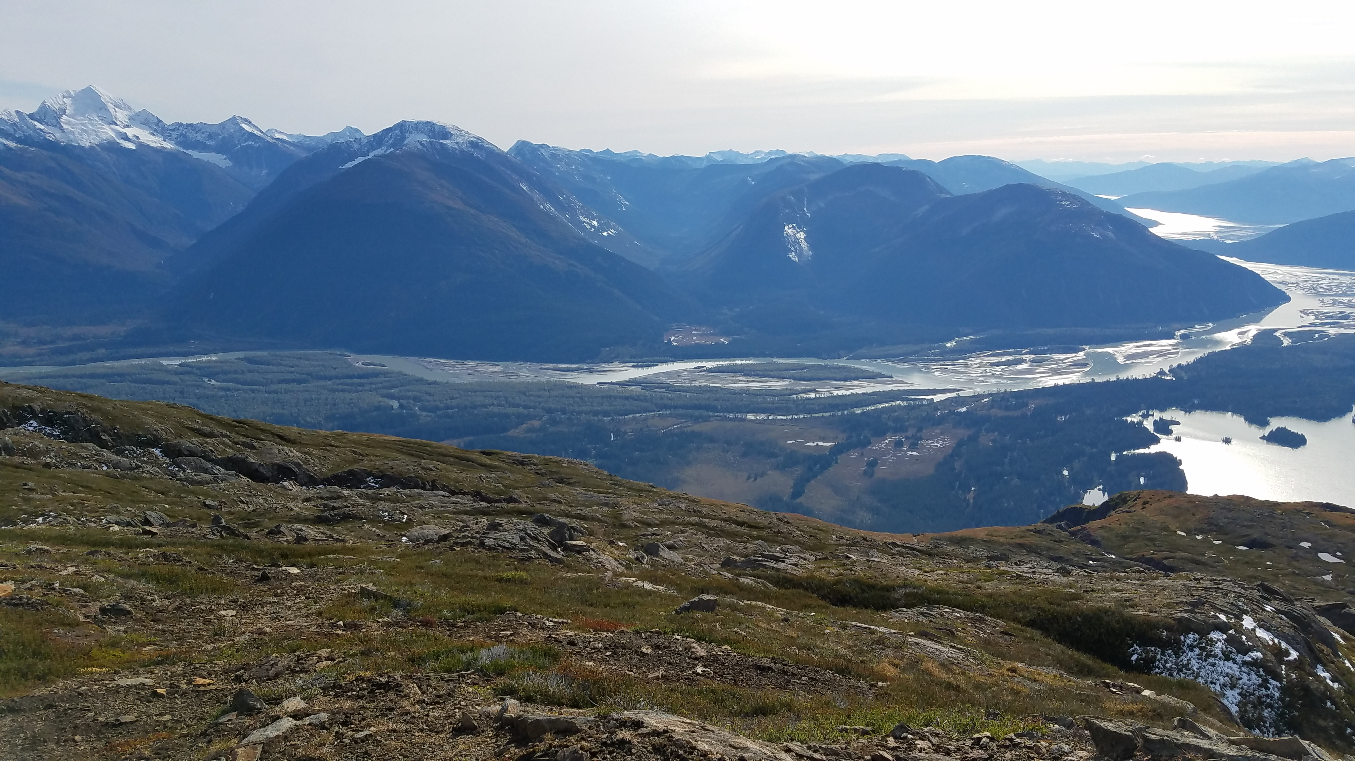
Outline
Data
Fishery
Results
Model fits
Params
Recommendations
Risk table
ABC/OFL
Surveys
Other
Derived quantities

Slide 4

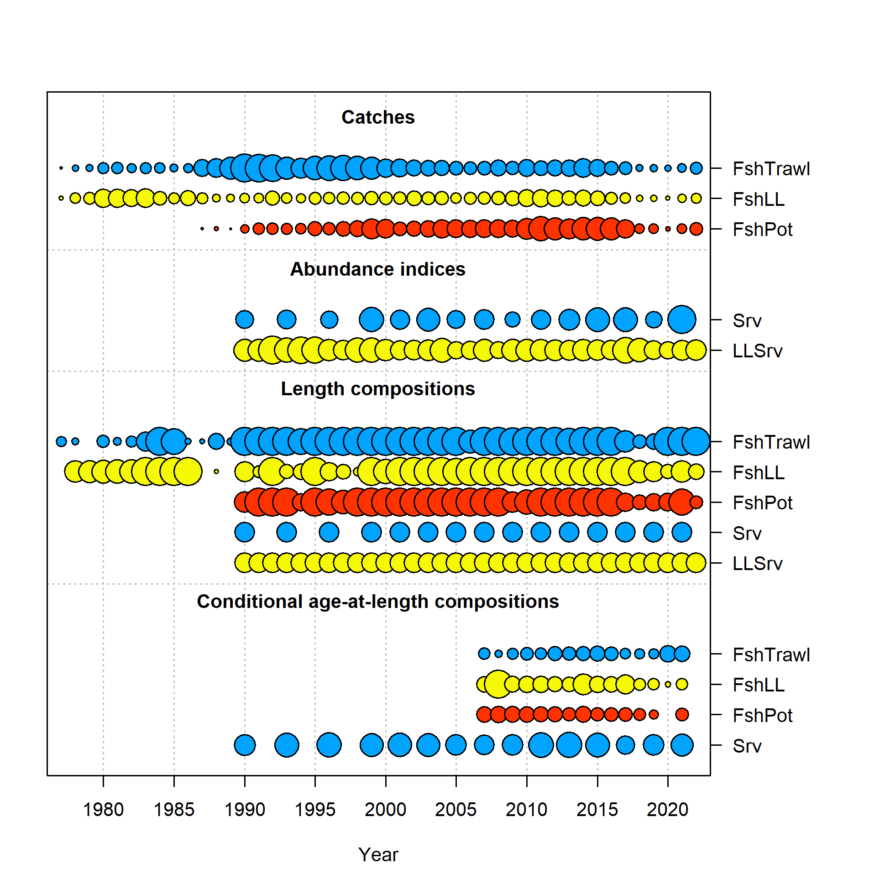
Data
Data | Years
Federal and state fishery catch, by gear type | 2021, 2022
Federal and state fishery catch-at-length, by gear type | 2021, 2022
AFSC Sablefish Longline survey Pacific cod Relative Population Numbers | 2022
GOA NMFS bottom trawl survey conditional age-at-length | 2021
AFSC Sablefish Longline survey Pacific Cod length composition | 2022
Federal fishery conditional age-at-length | 2021
CFSR bottom temperature indices | 2022

Slide 5
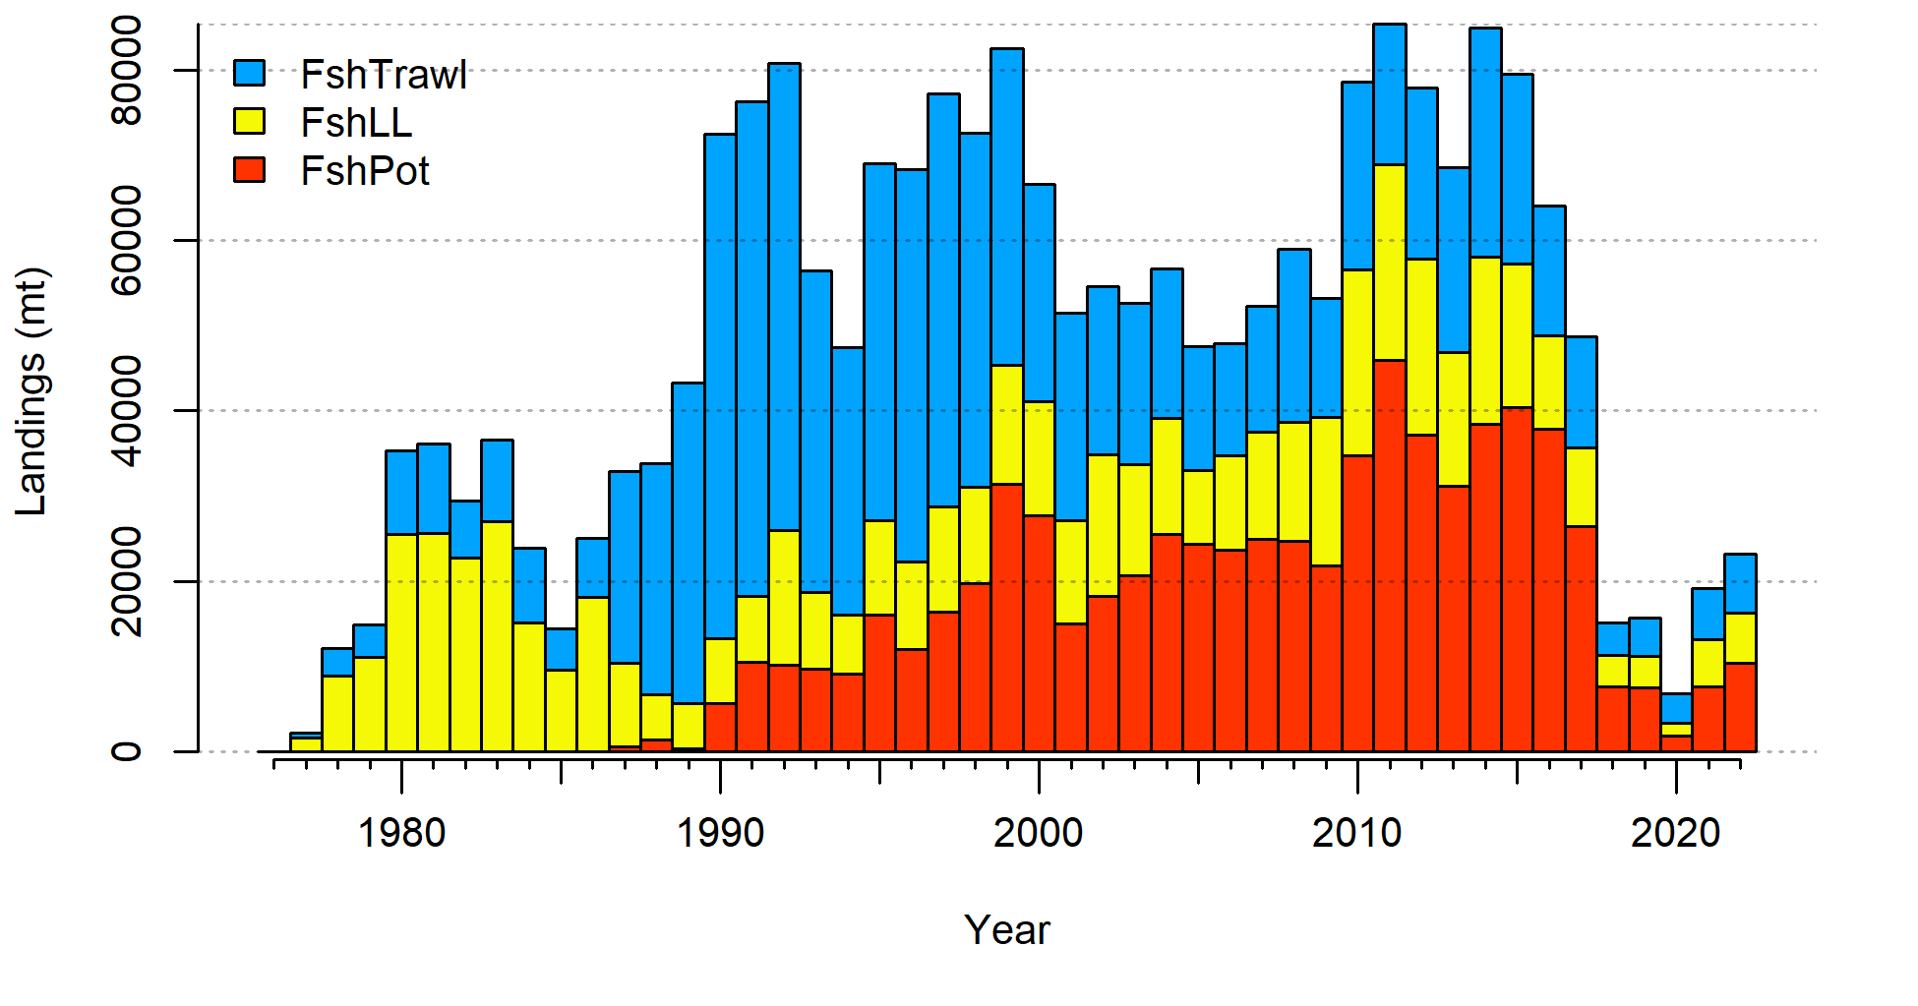
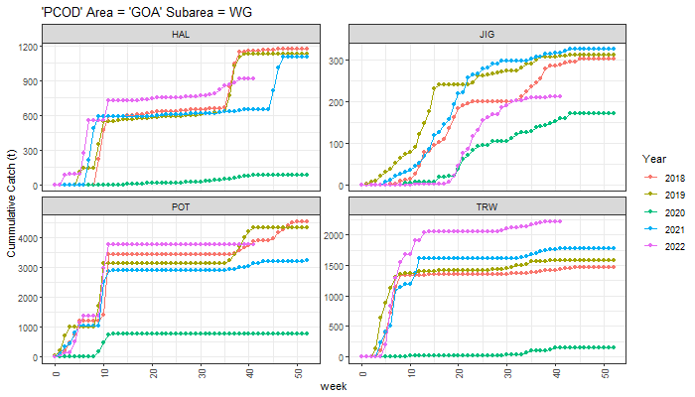
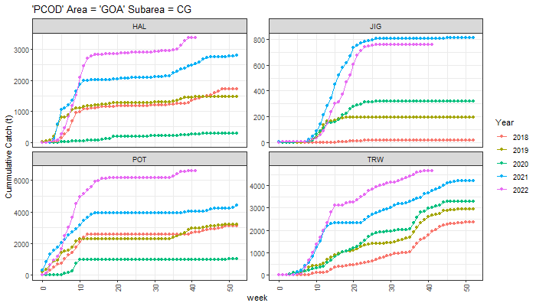
Data - Catch
Increased since 2021
Pot majority > Trawl > LL
CG greatest increase compared to last year

Slide 6
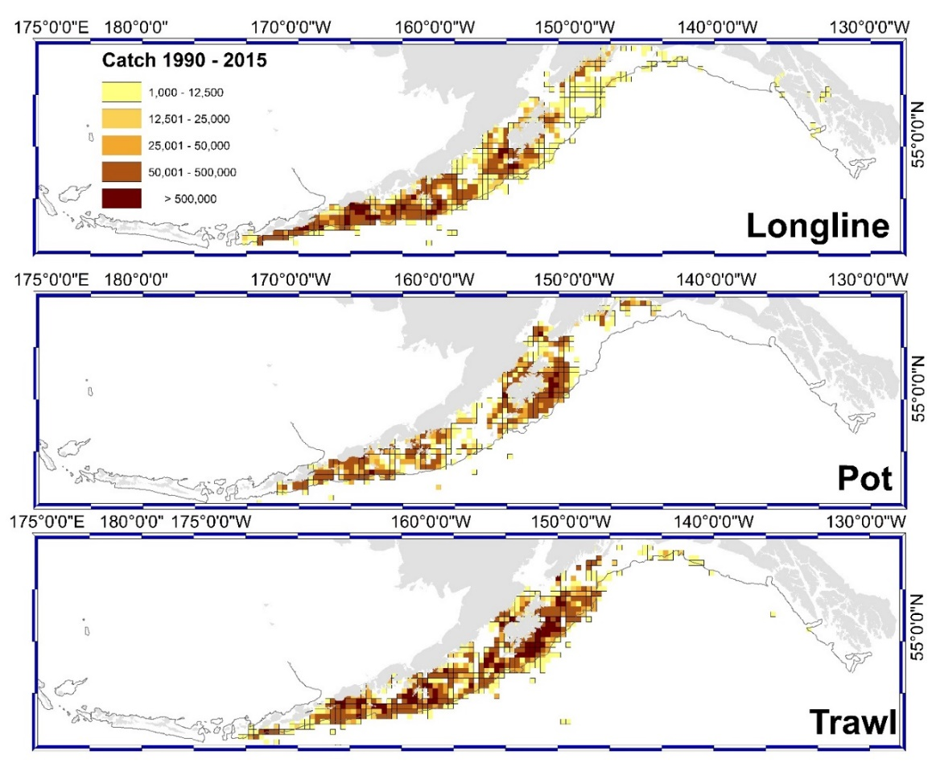
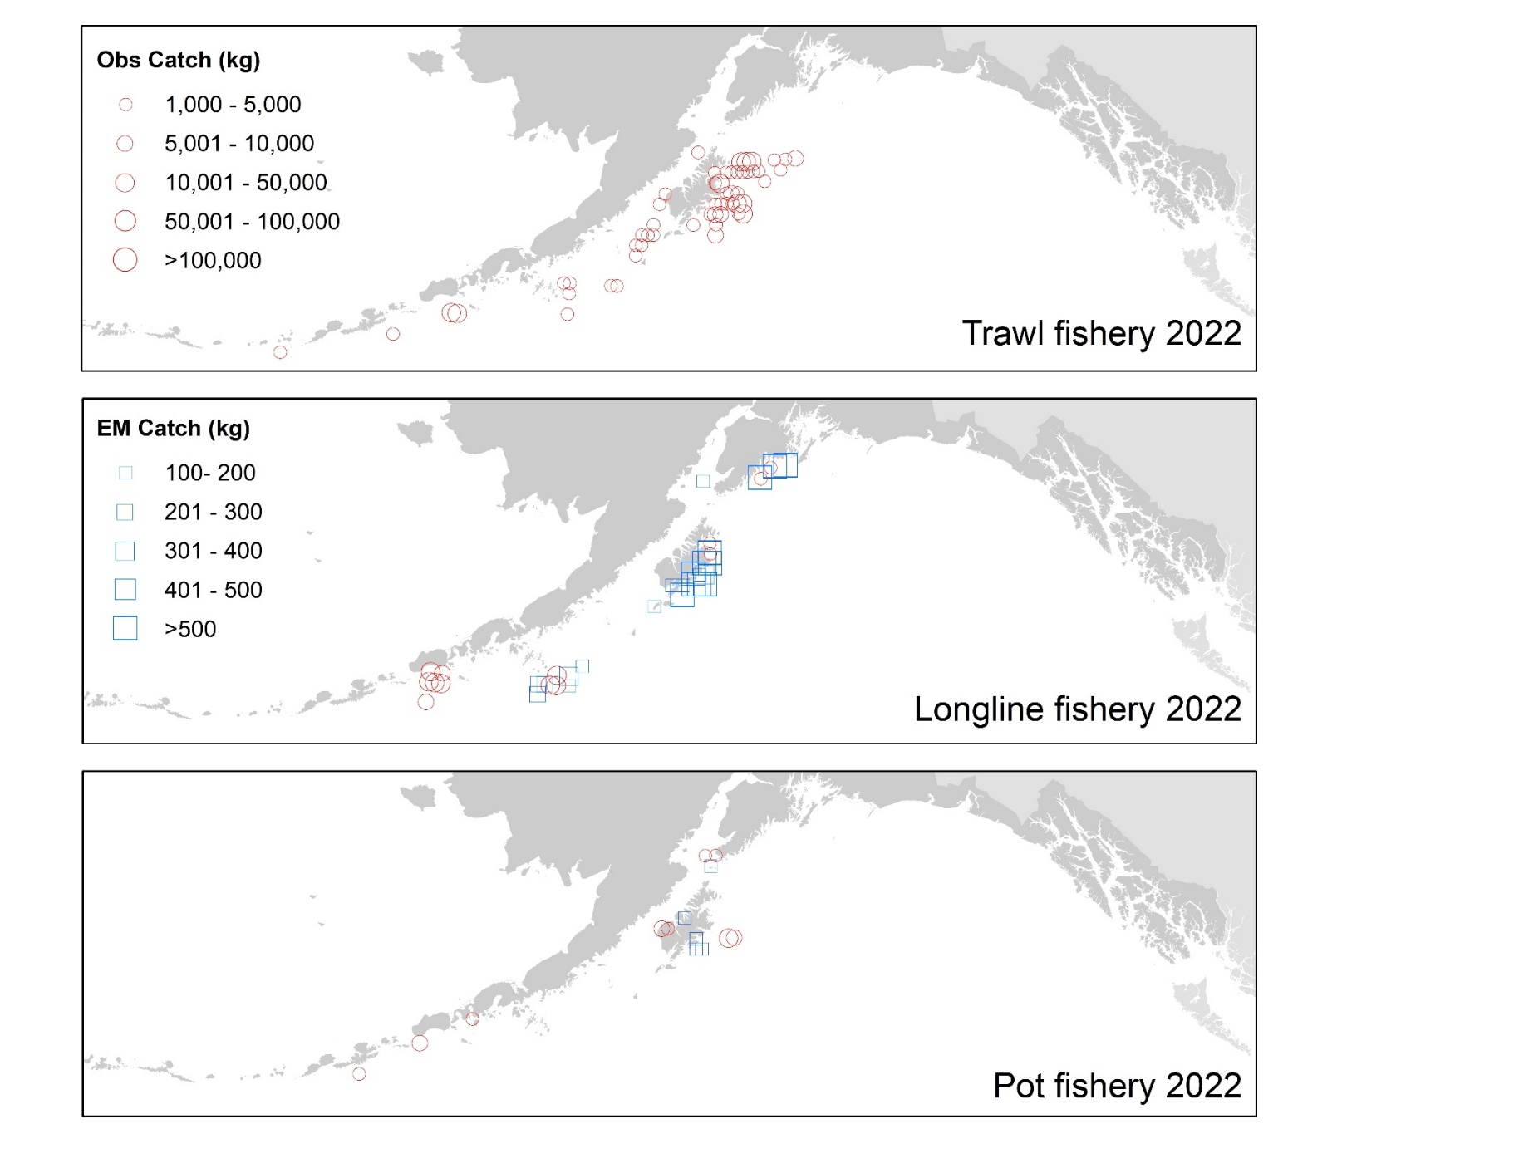
Data – Catch distribution
Recent catch seems to be constricting to core areas compared to historical

Slide 7
Data – state catch
Noticed 1997 – 2002 state catch reported in SAFE table, but not in model time series (11 – 22% of total catch)…
Has to do with data tables/sources we’re pulling from

Slide 8
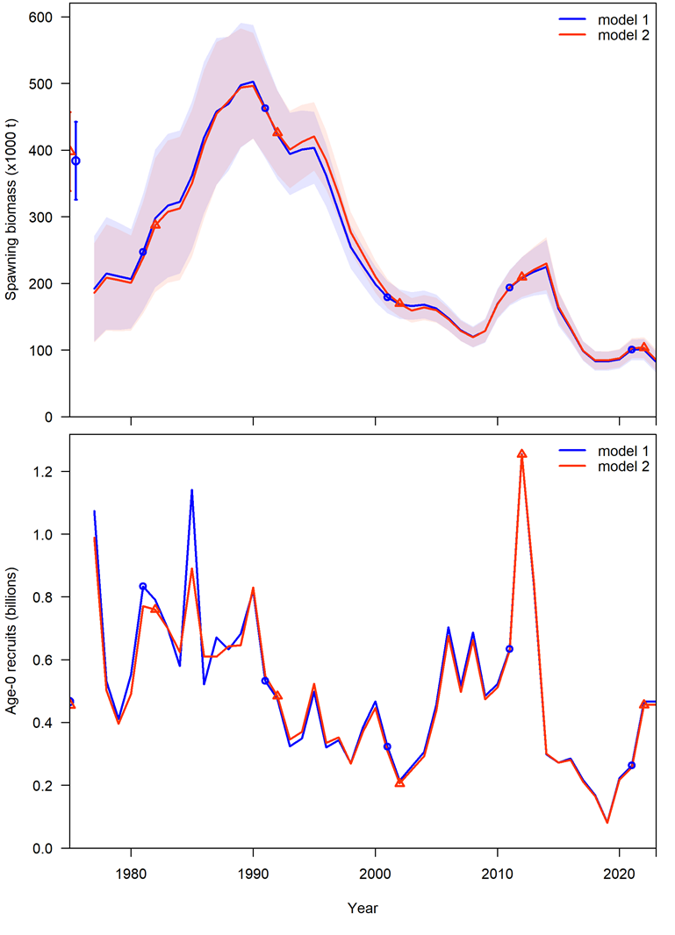
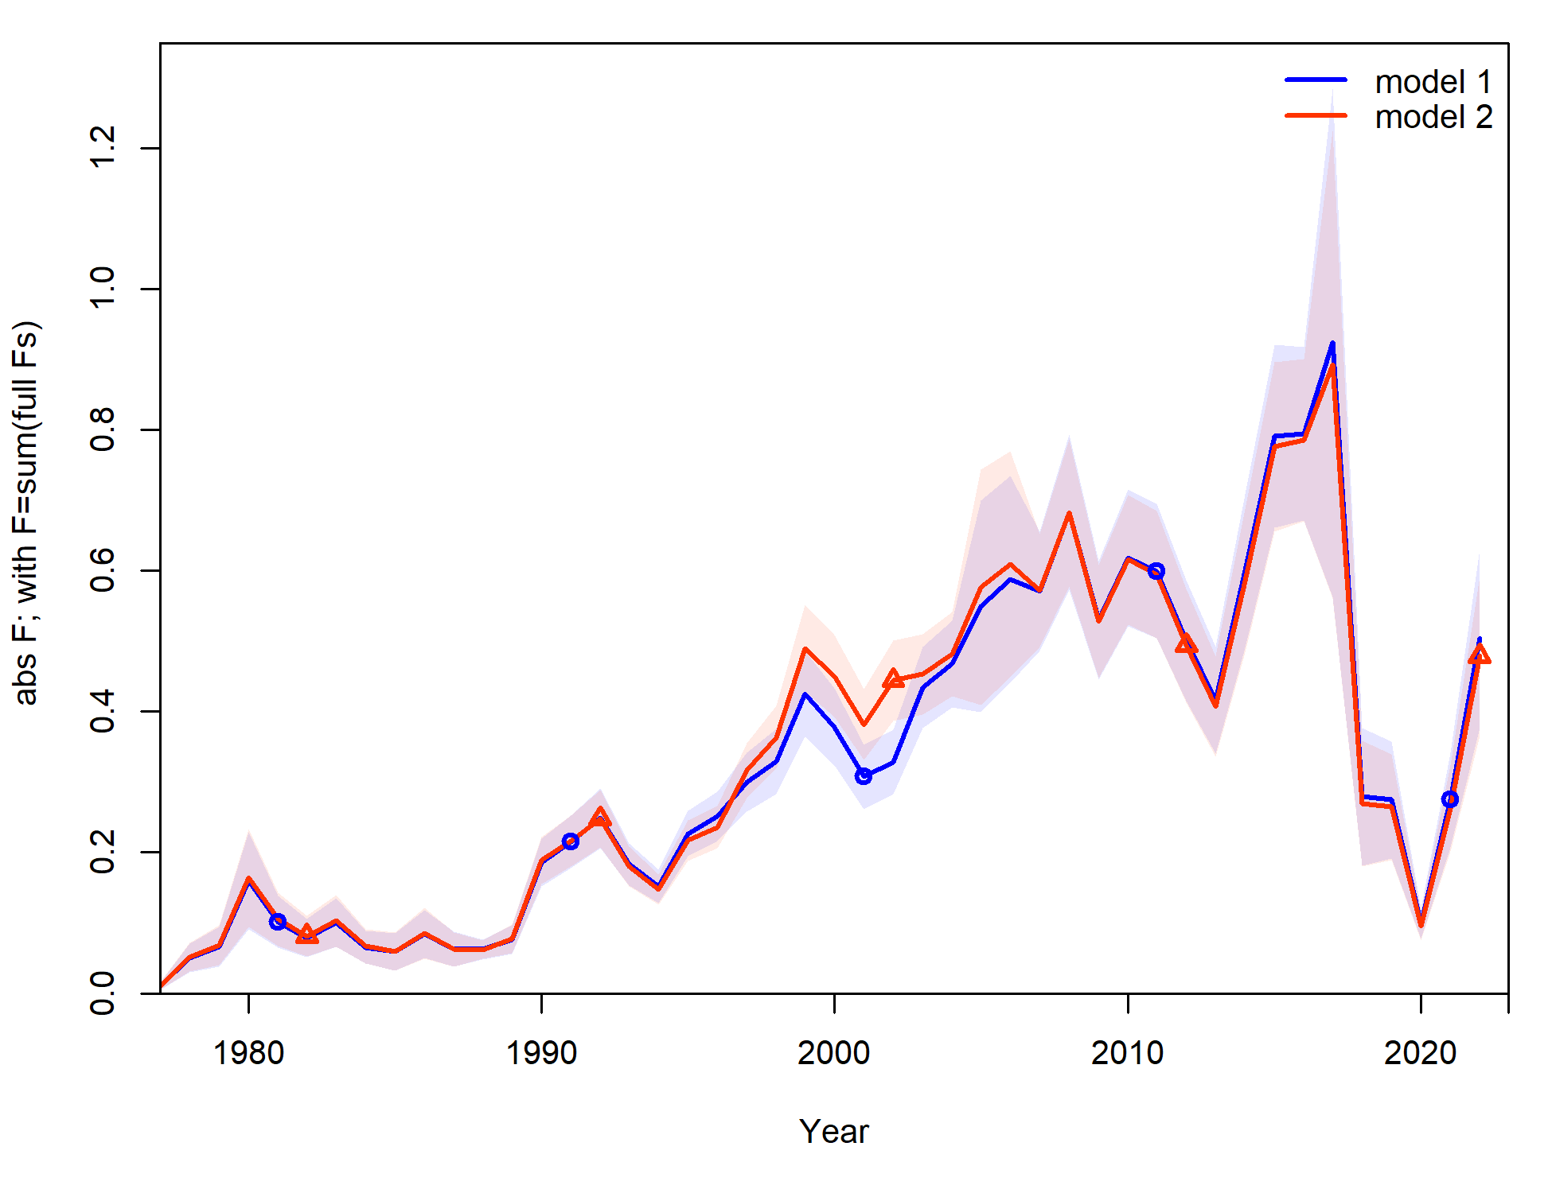
Data – state catch
Appendix 2.2 of SAFE shows changes to model when including 1997 – 2002 state catch
In this and future assessments this catch will be included, change name from Model 19.1 to Model 19.1a to note this addition

Slide 9
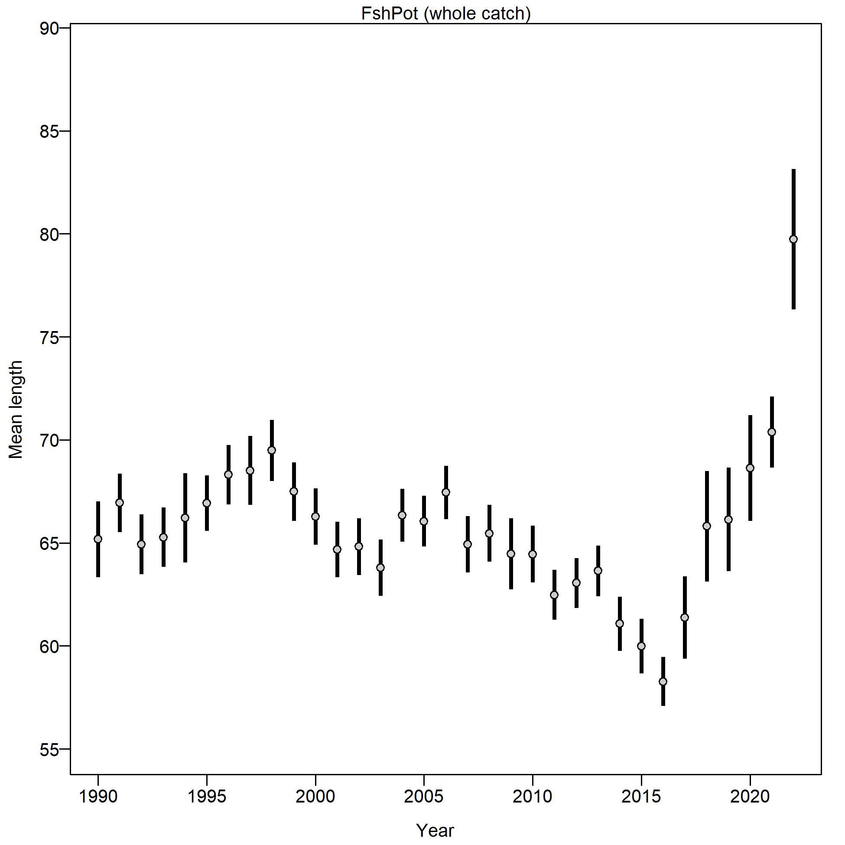
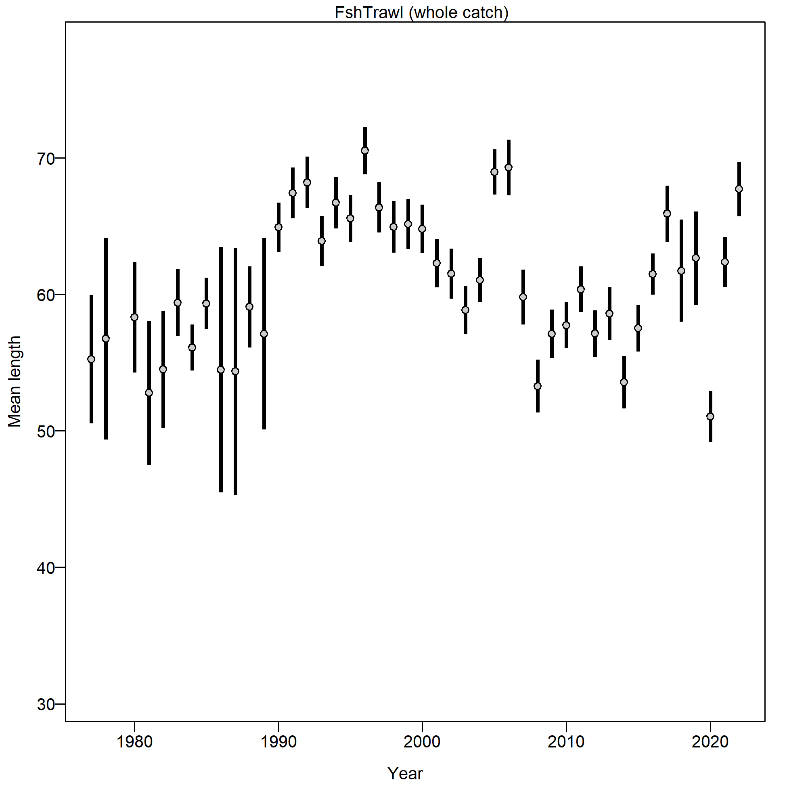
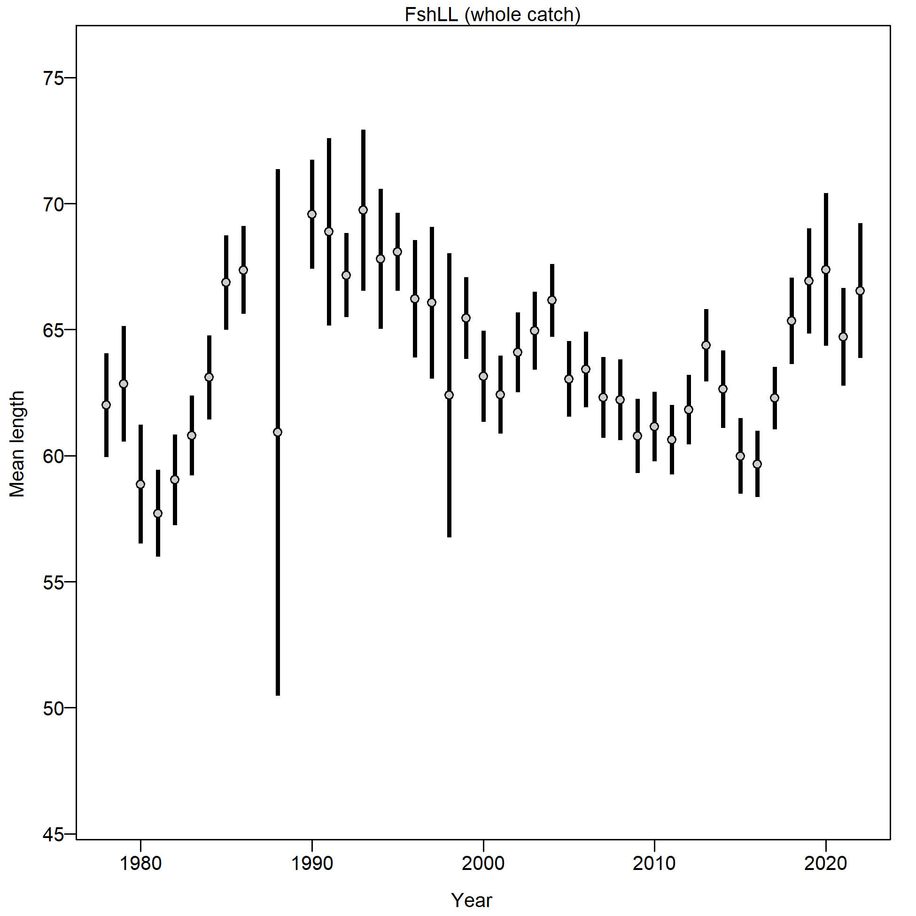
Data – catch comps
In general, mean length increasing in fishery
Significantly larger mean length resulted in Pot fishery
Pot
Trawl
Longline

Slide 10
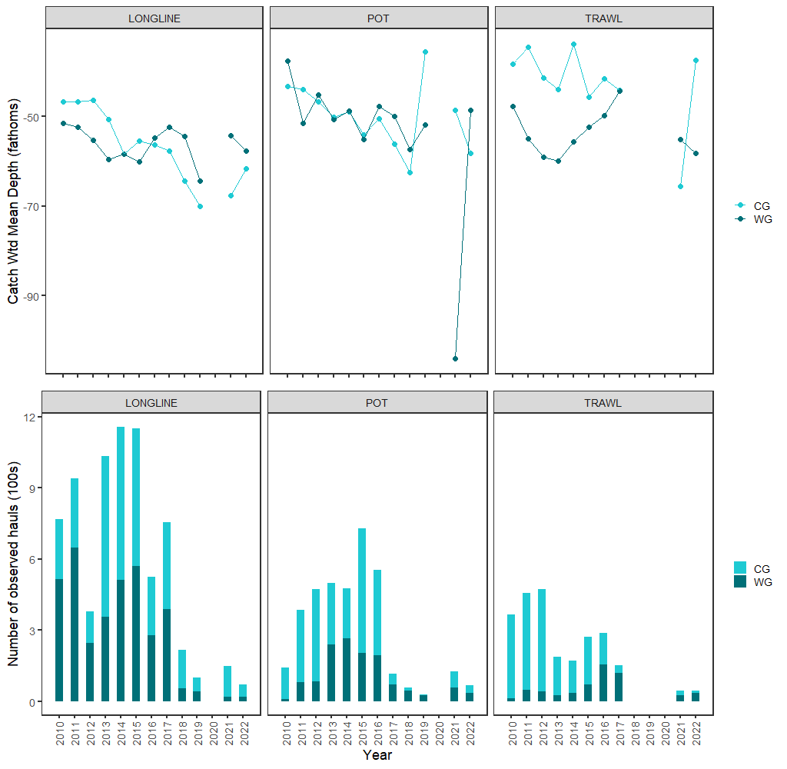
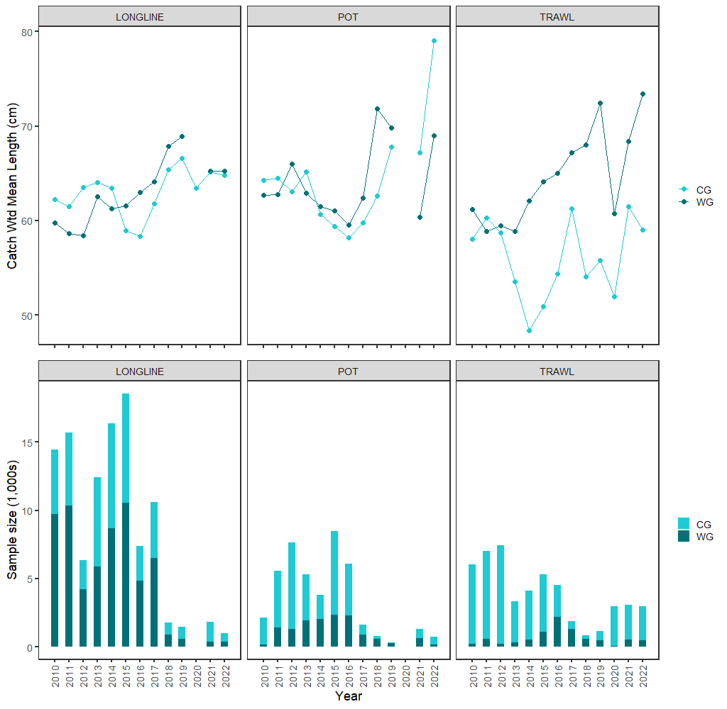
Data – catch comps
In general, moving deeper
Pot length driven by CG samples, may be some catch left in WG

Slide 11
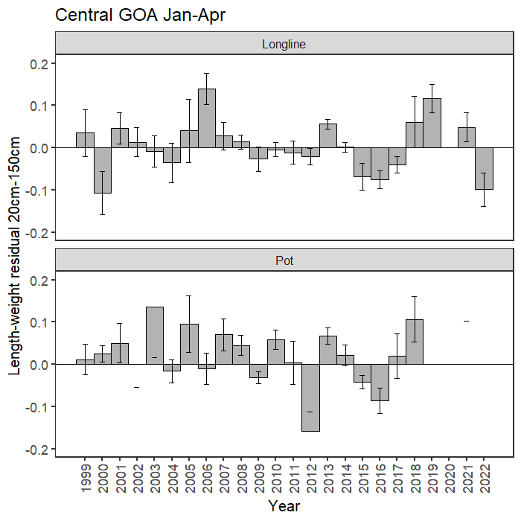
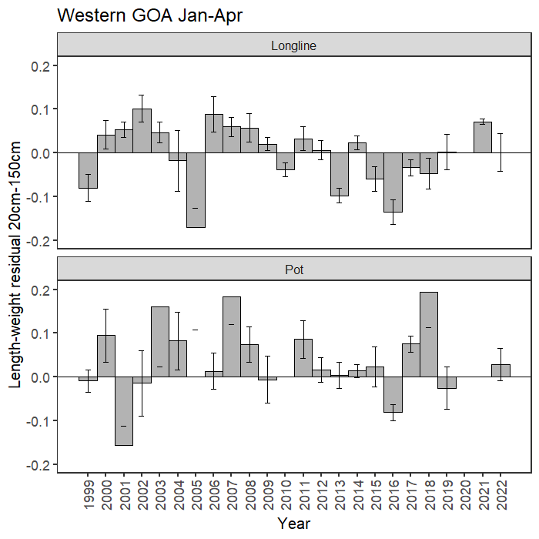
Data – catch condition
Avg in WG, below avg in CG Longline

Slide 12
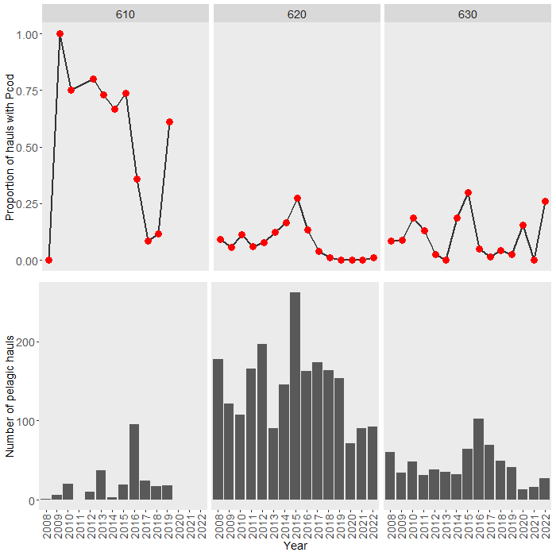
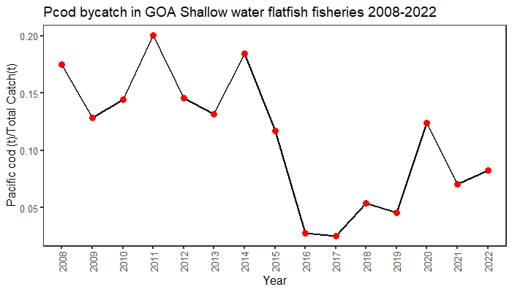
Data – unintentional catch
Getting Pcod in pelagic trawls
SWF bycatch on increasing trend

Slide 13
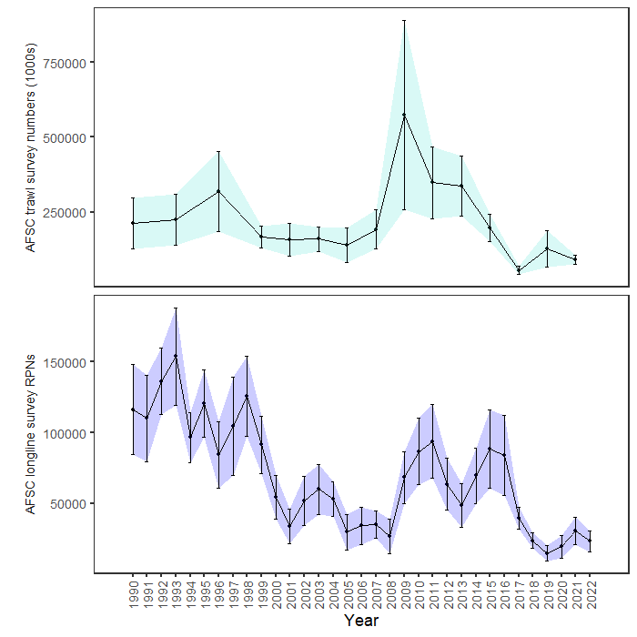
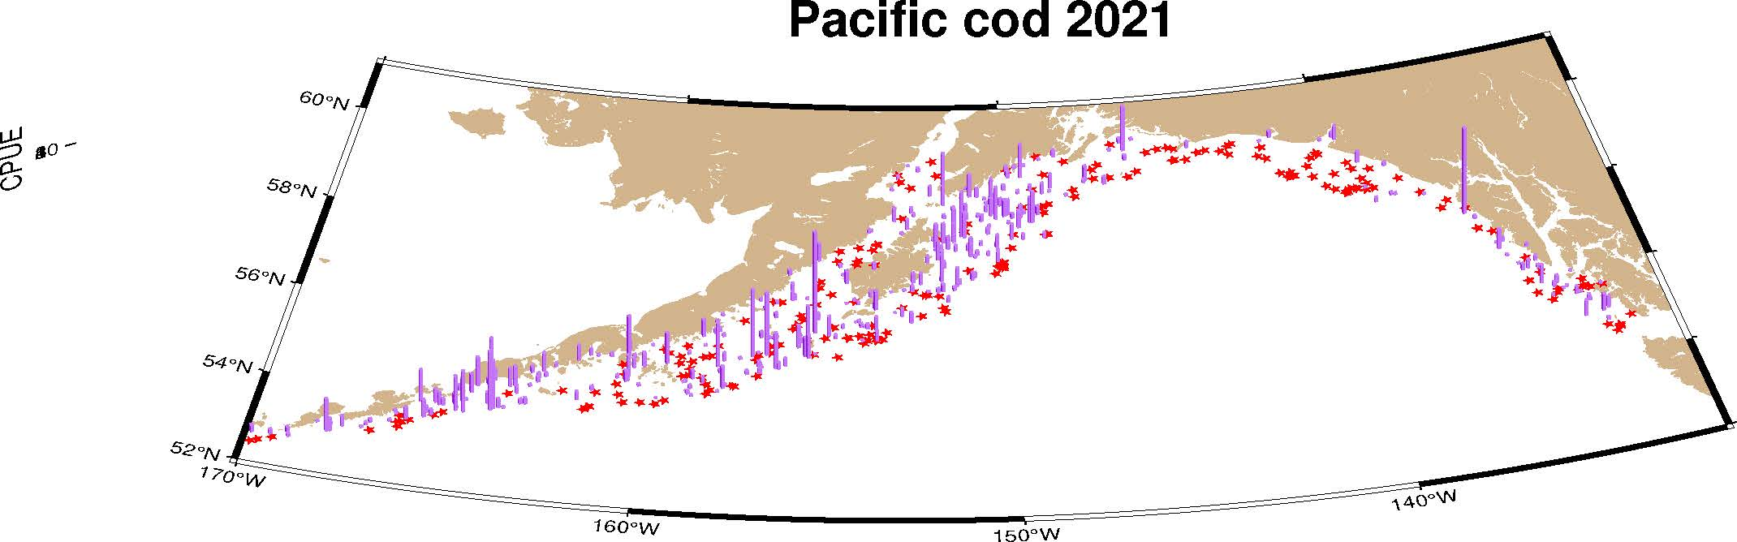
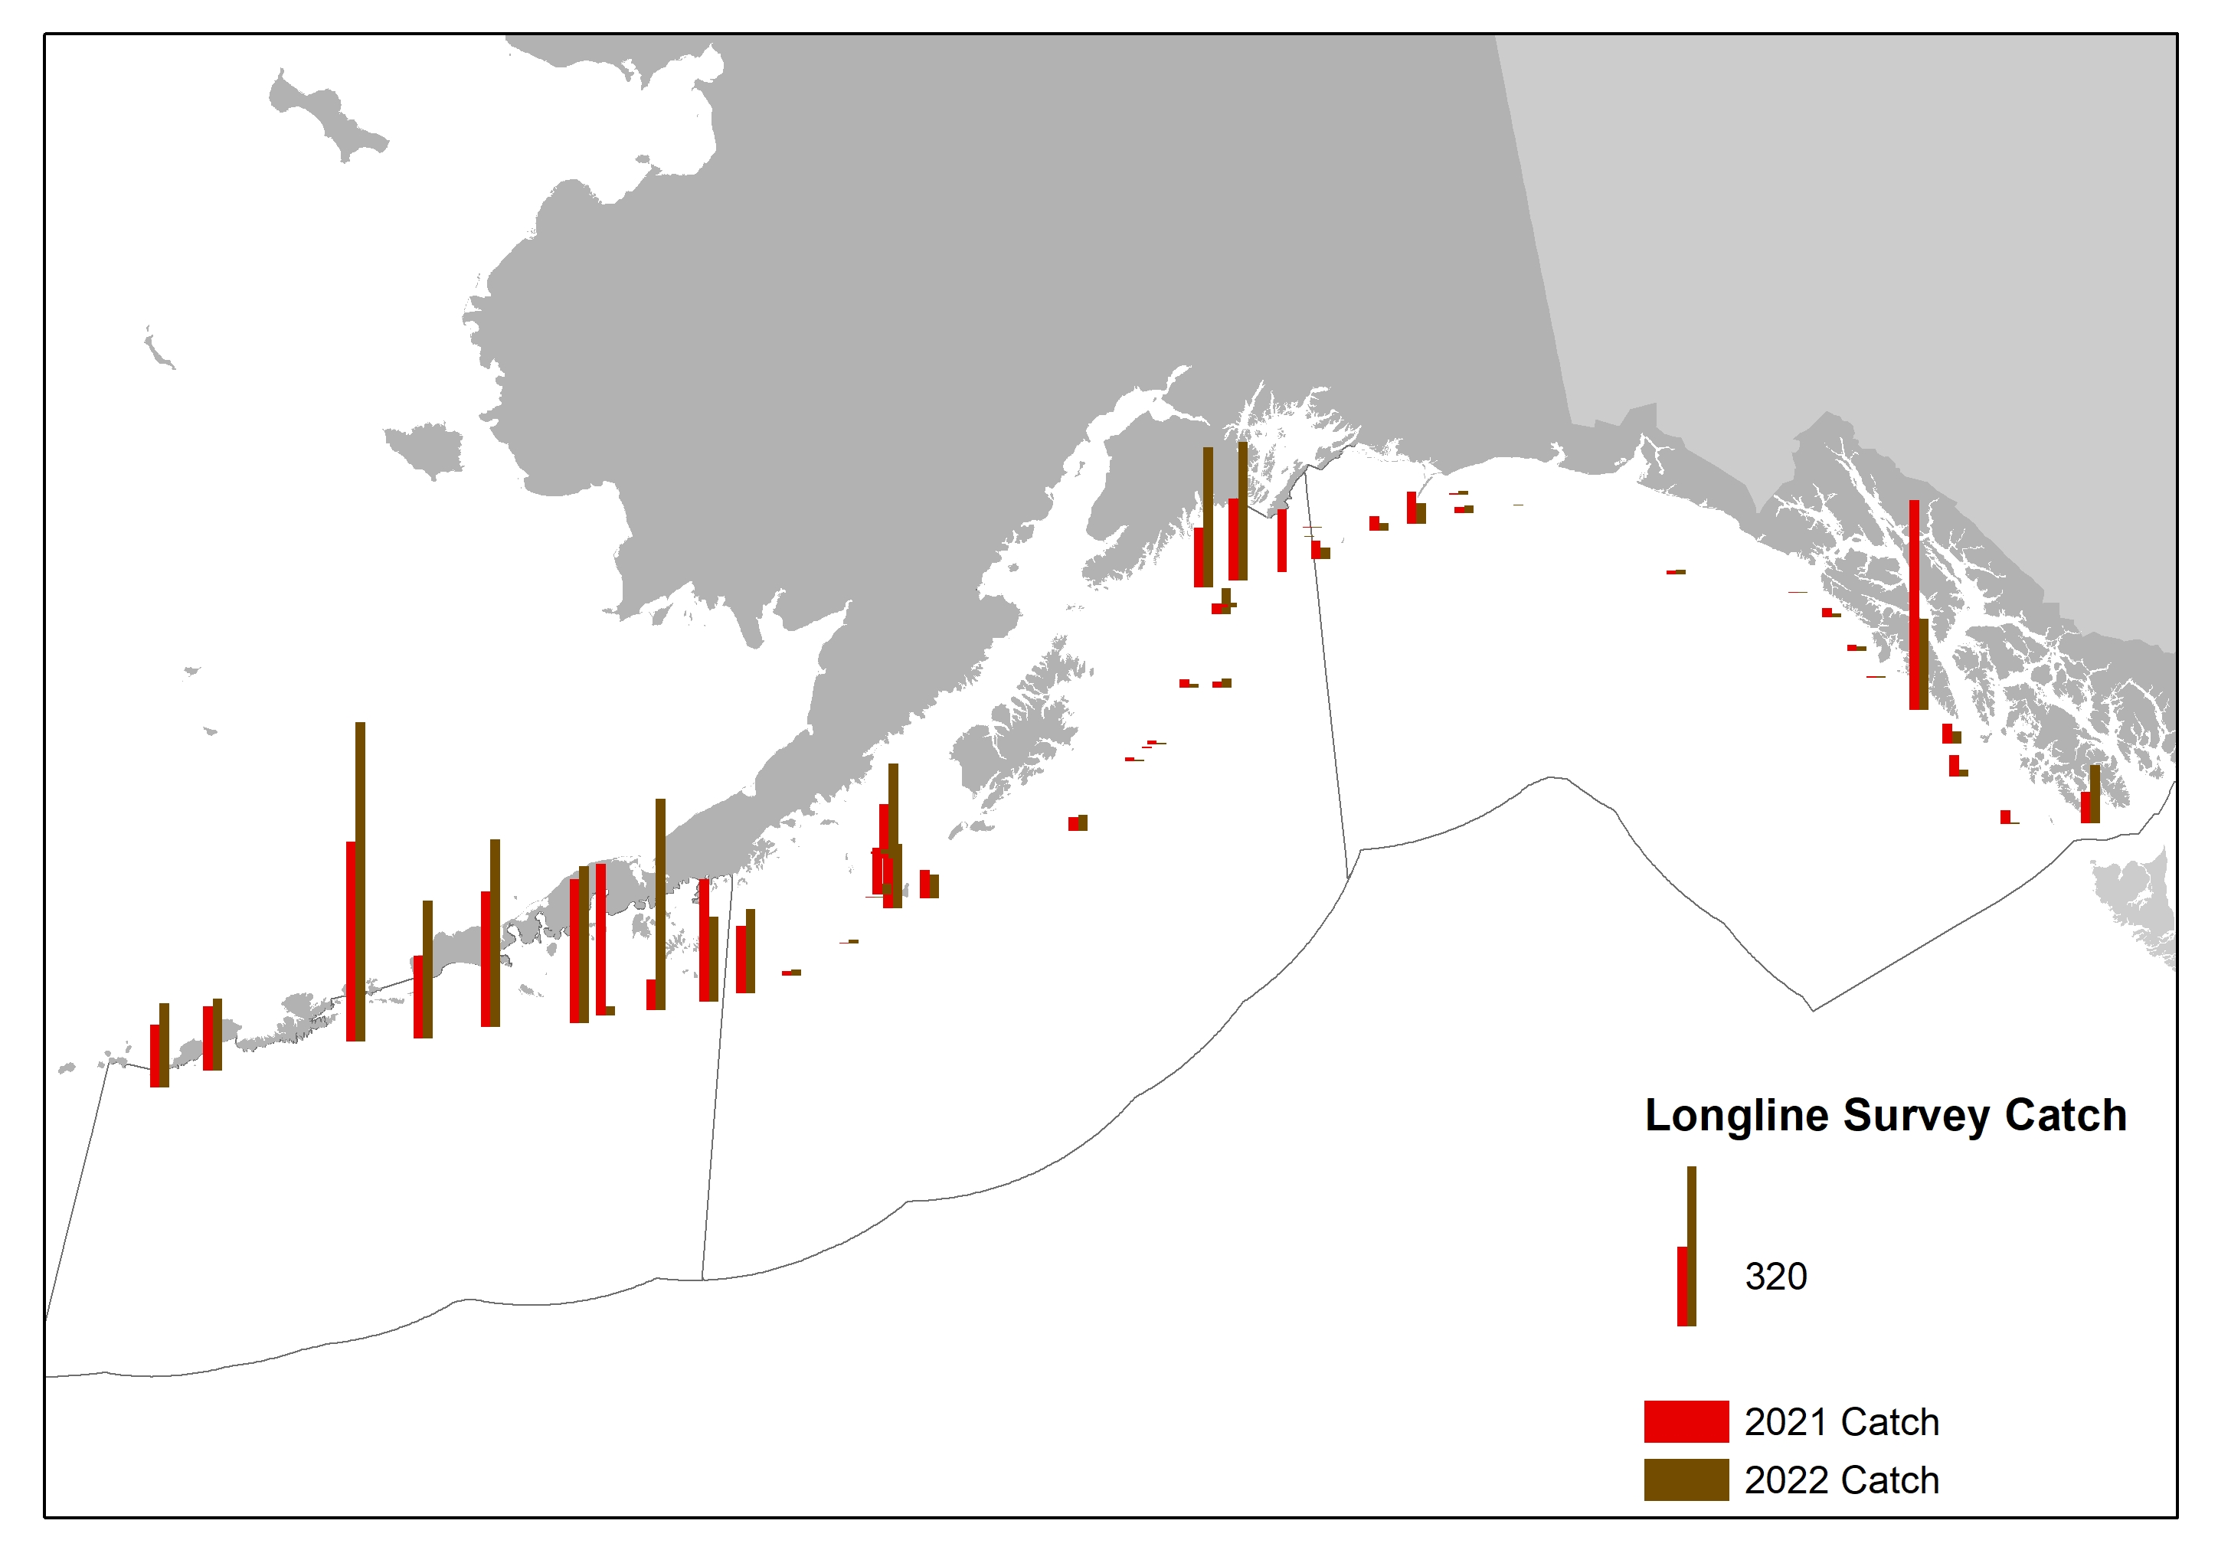
Surveys – fitted
-24%

Slide 14

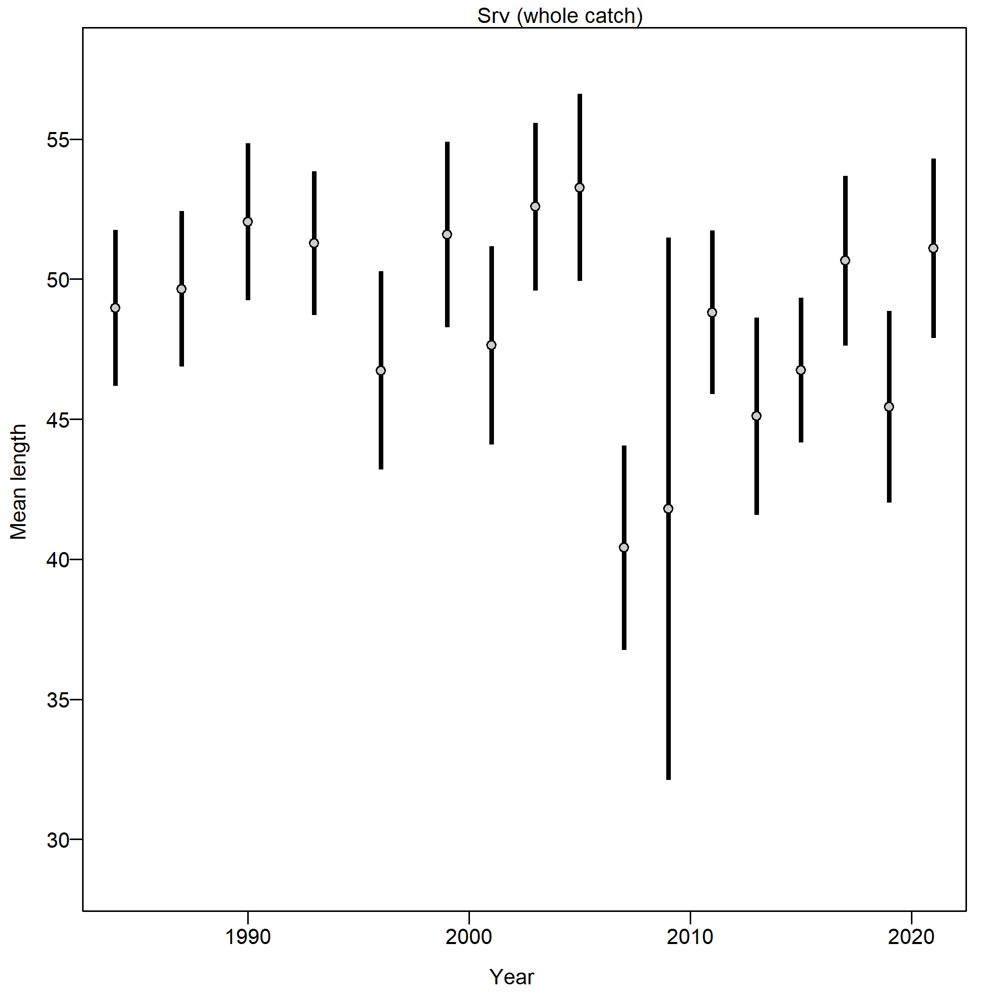
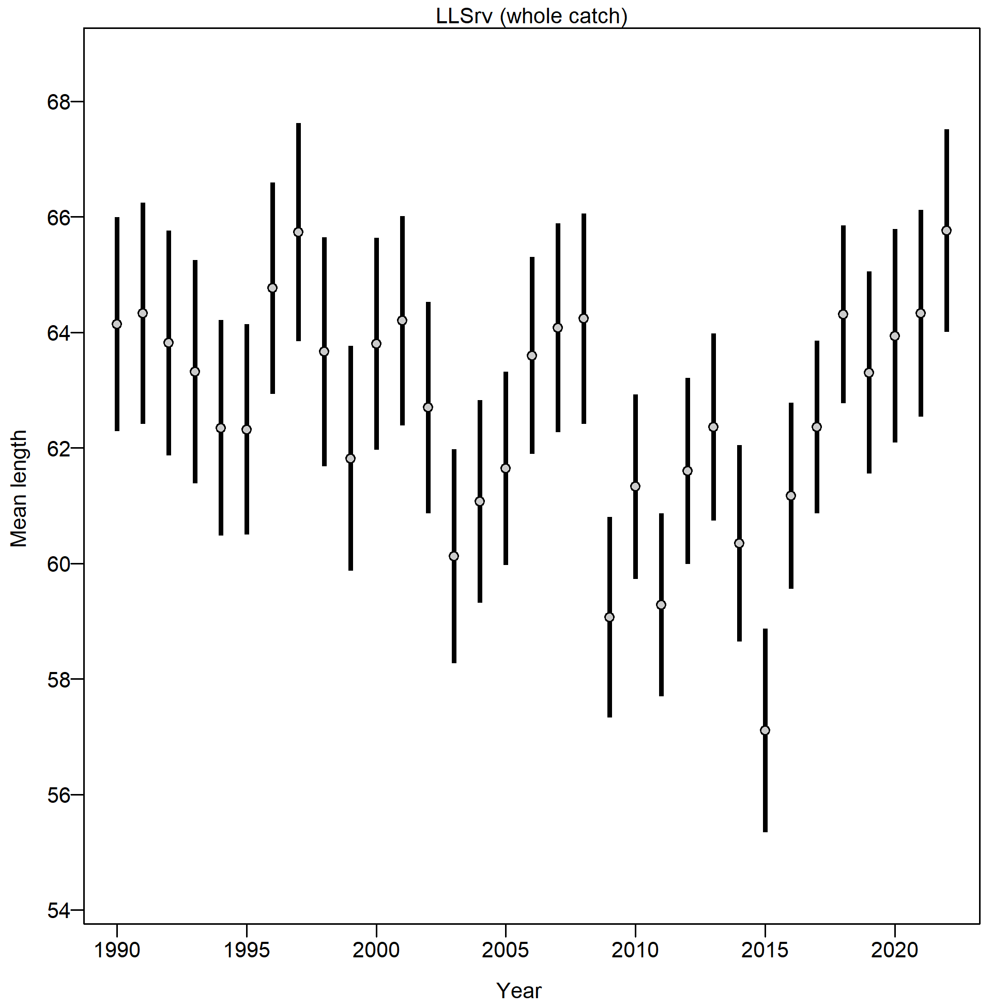
Surveys – Fitted
Trawl survey mean length variable
Longline survey mean length increasing

Slide 15
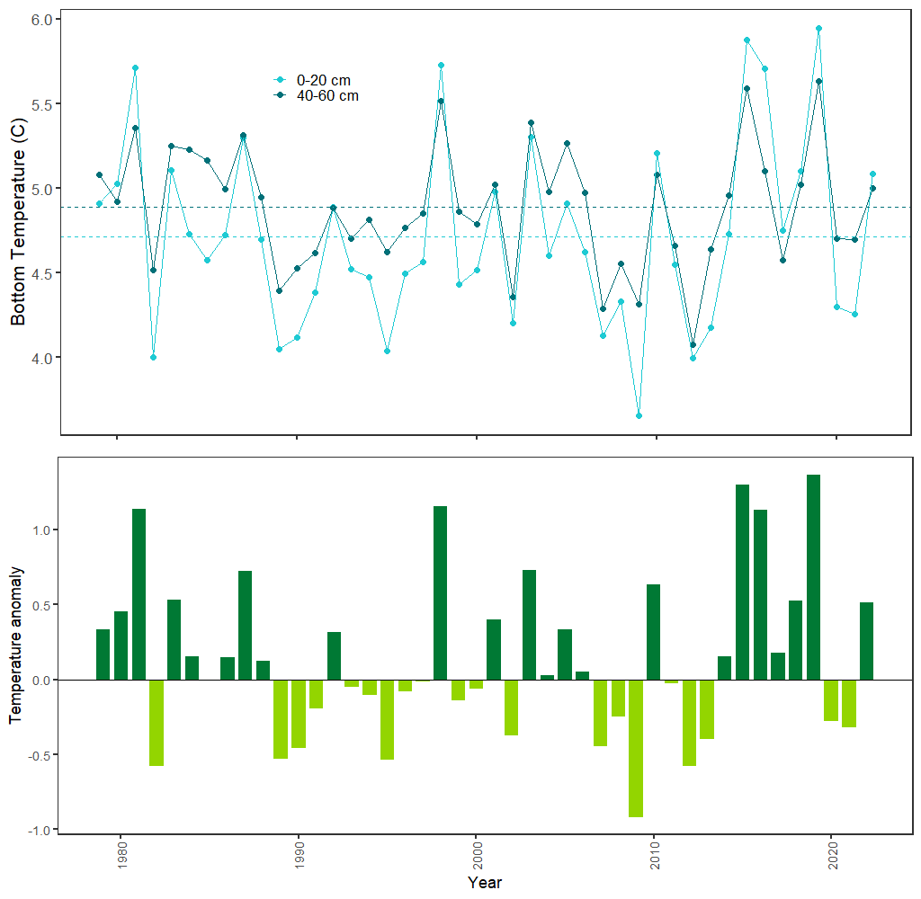
Surveys – Env data
Bottom temperature above mean in 2022

Slide 16
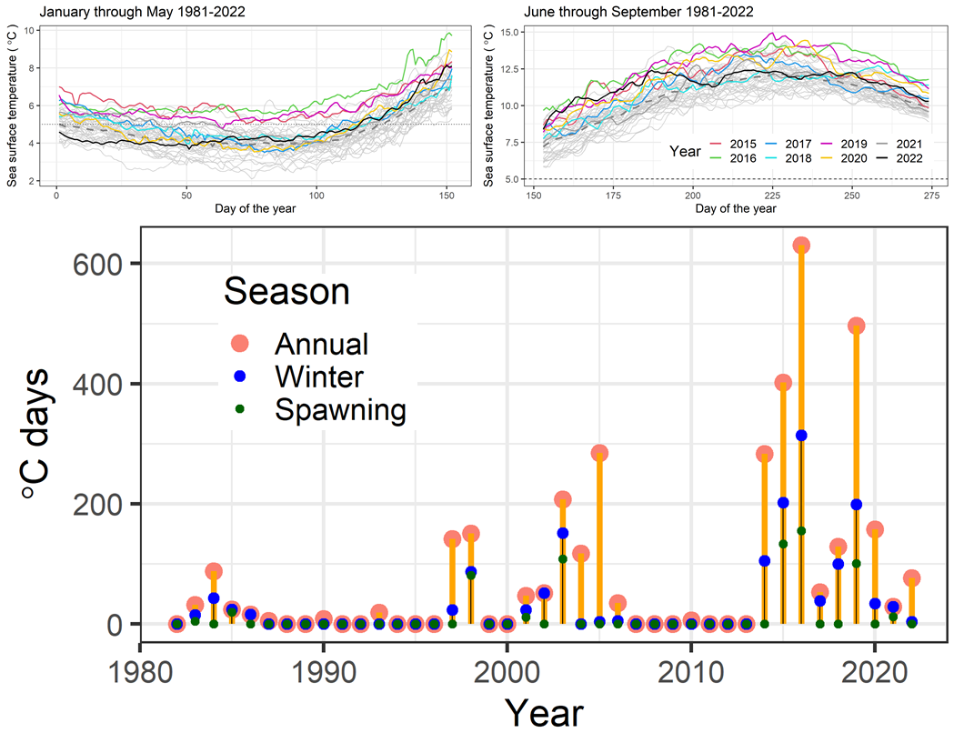
Surveys – Env data
Avg to above avg sea surface temperature
No marine heat wave days during winter/spawning

Slide 17
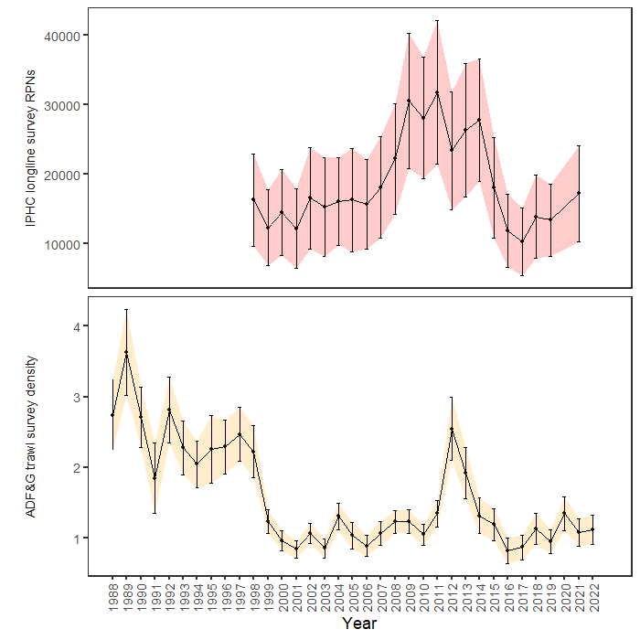
Surveys – monitored
Both IPHC and ADF&G on increasing trend

Slide 18
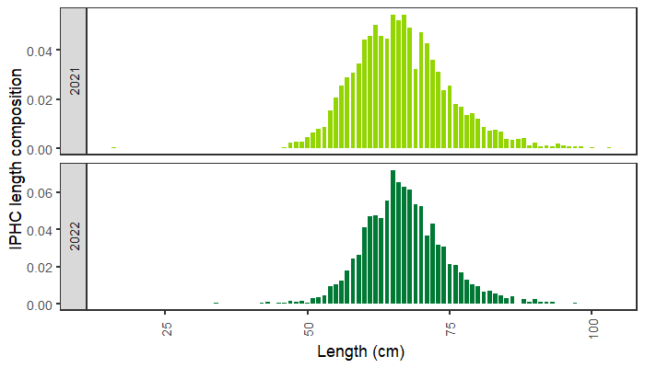
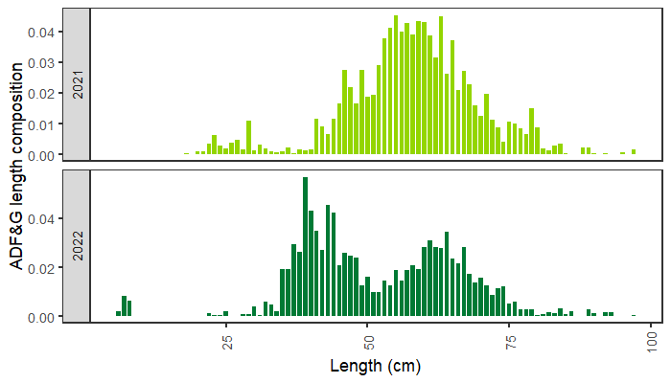
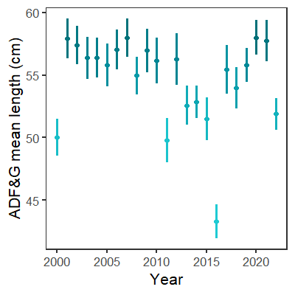
Surveys – monitored
IPHC – adult pop’n
ADF&G – picking up 2020 year class (particularly around Kodiak

Slide 19
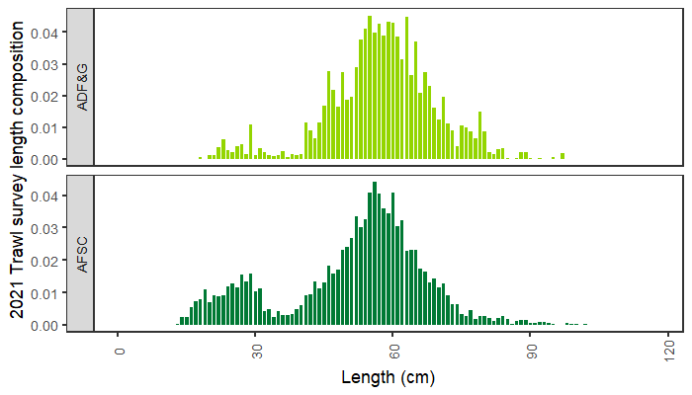
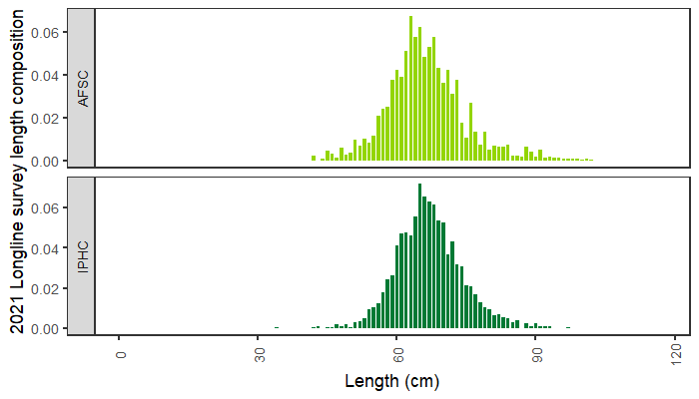
Surveys – monitored
Similarities in most recent length comps by survey gear types

Slide 20
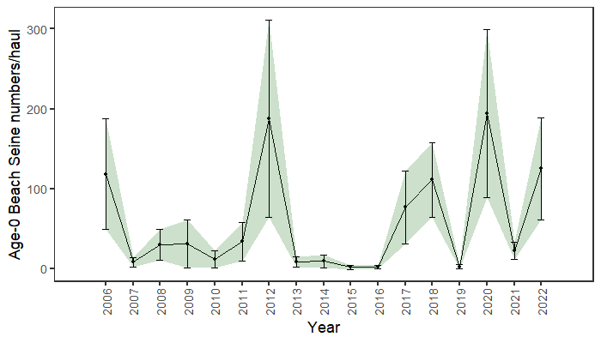
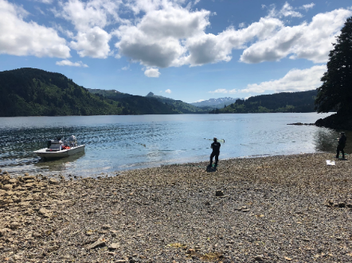
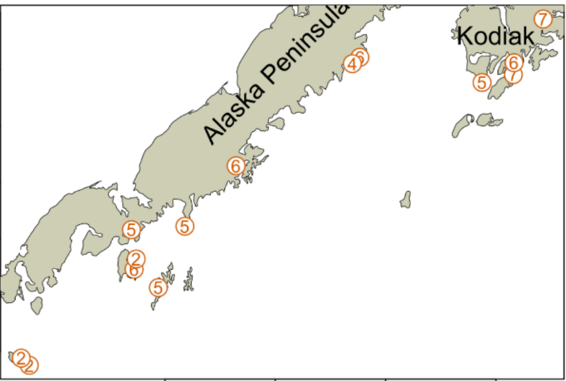
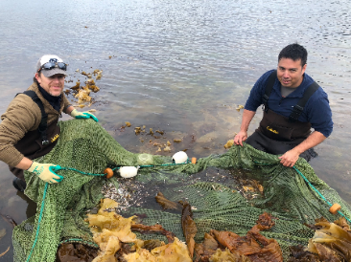
Surveys – monitored
Increased 2022 year class

Slide 21
Data – summary
Mean length increasing
Fishery trending towards deeper water
No small fish in length comps
Increasing/positive trends
IPHC, ADF&G, SWF bycatch all indicate increasing trends and see different aspects of pop’n
4 of 6 most recent years in age-0 survey larger year classes, or, not 0
Last 3 years don’t have a lot of marine heat wave days
Longline survey RPNs decreased

Slide 22
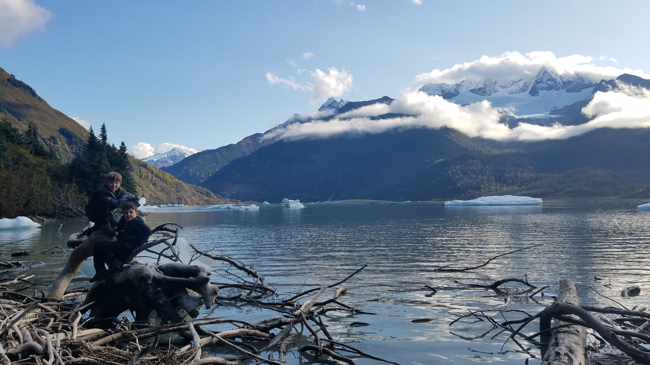
results
Data fits
Model estimates
Summary

Slide 23
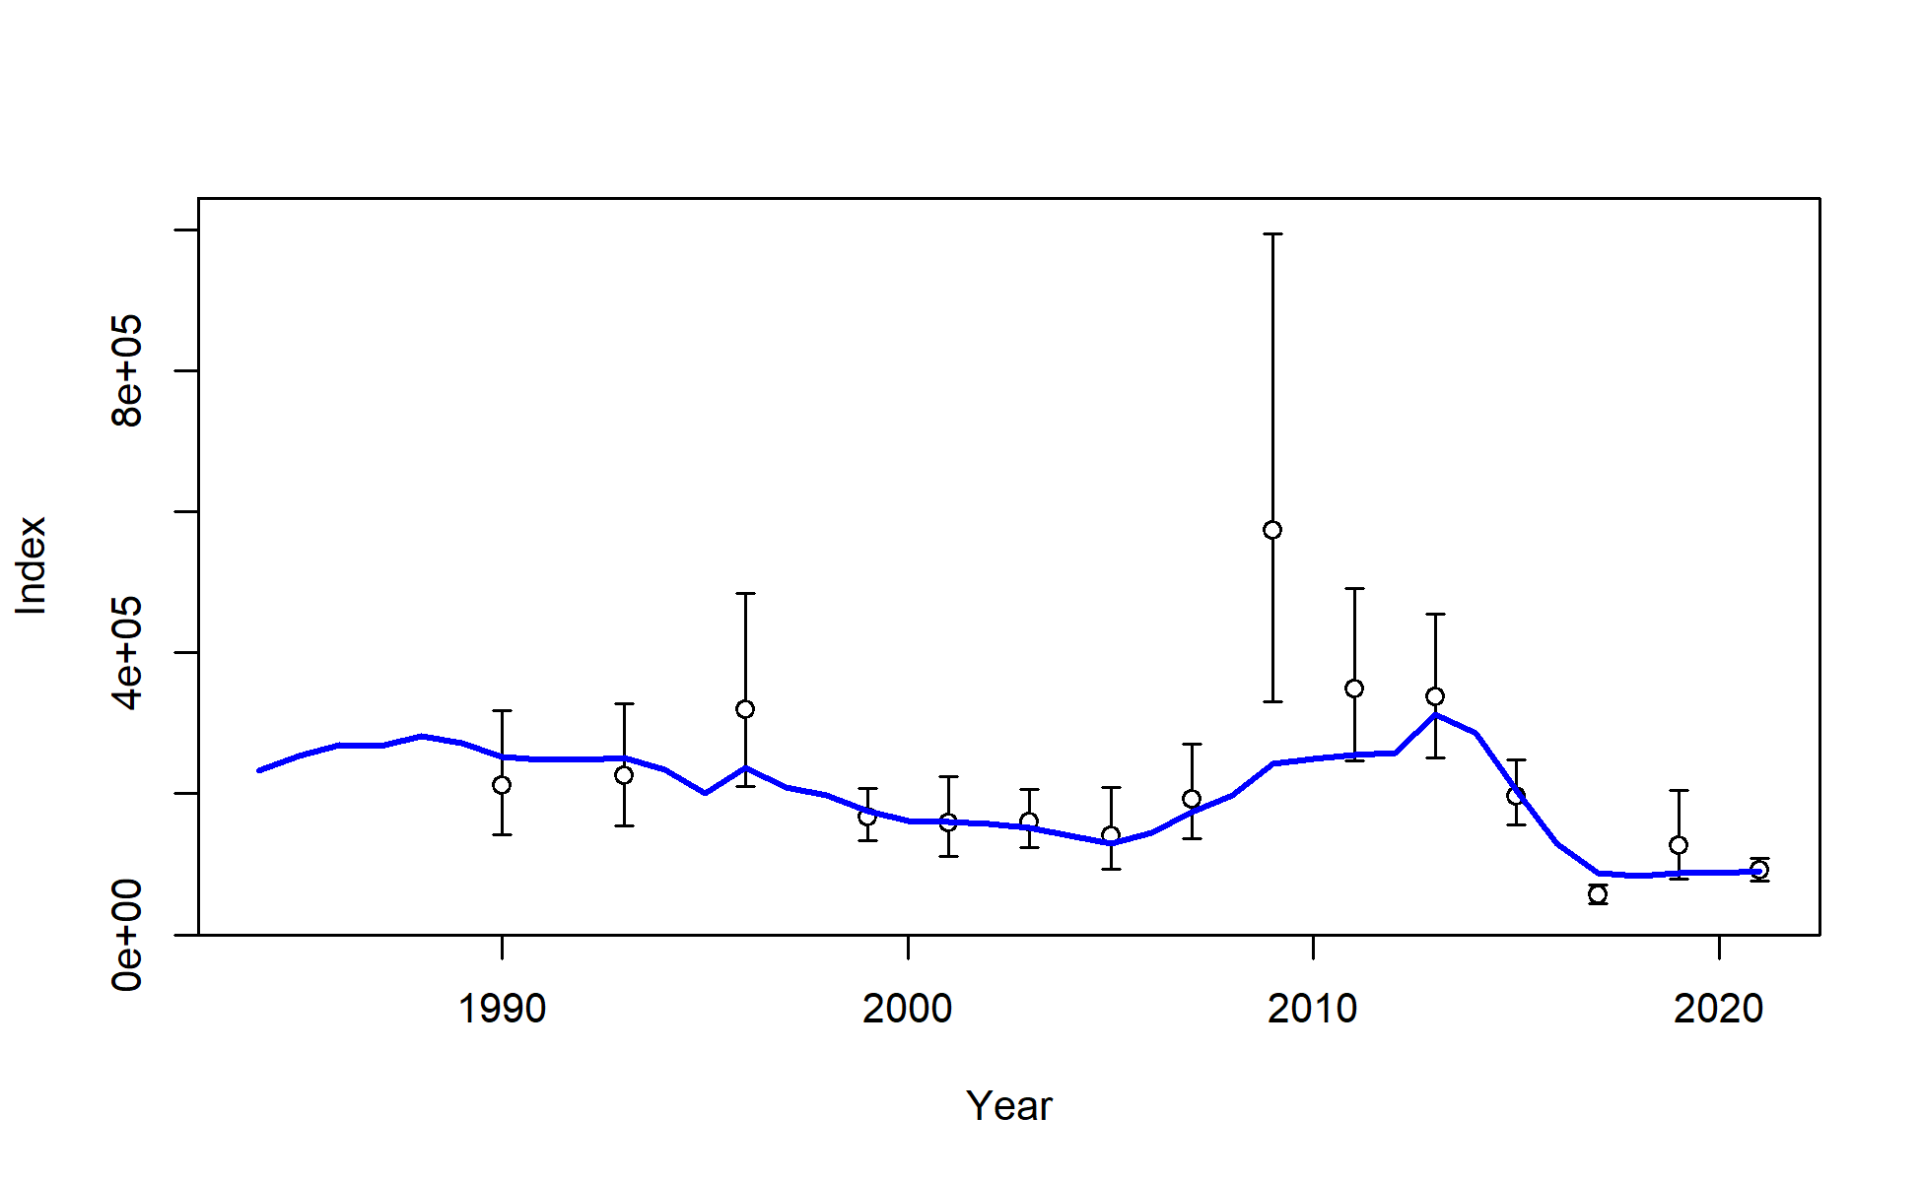
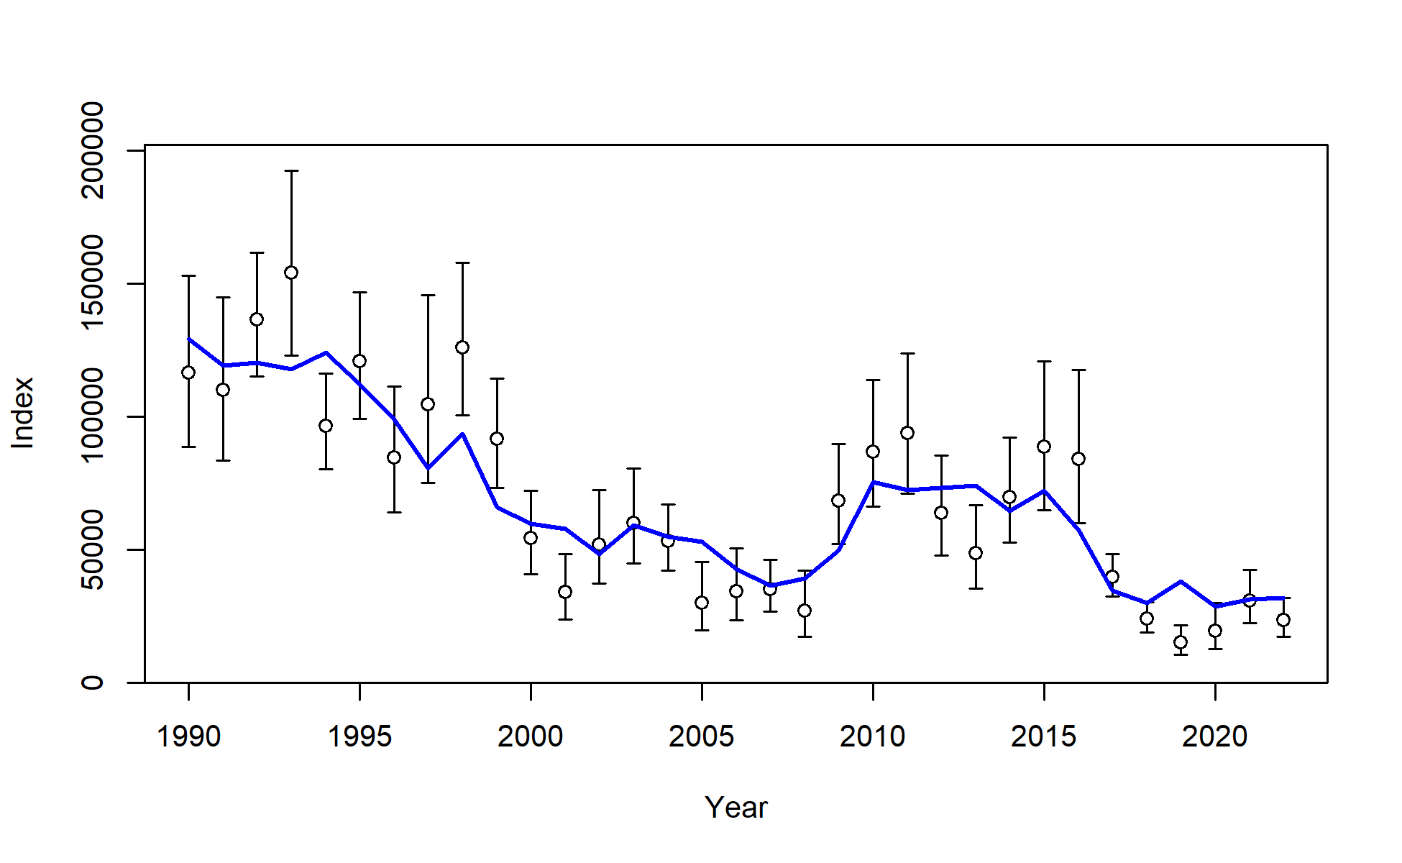
Results: data fits
Continuing to fit 2021trawl survey precisely
Expecting larger RPN from longline survey in 4 of last 5 years
AFSC bottom trawl survey numbers
AFSC longline survey RPNs

Slide 24
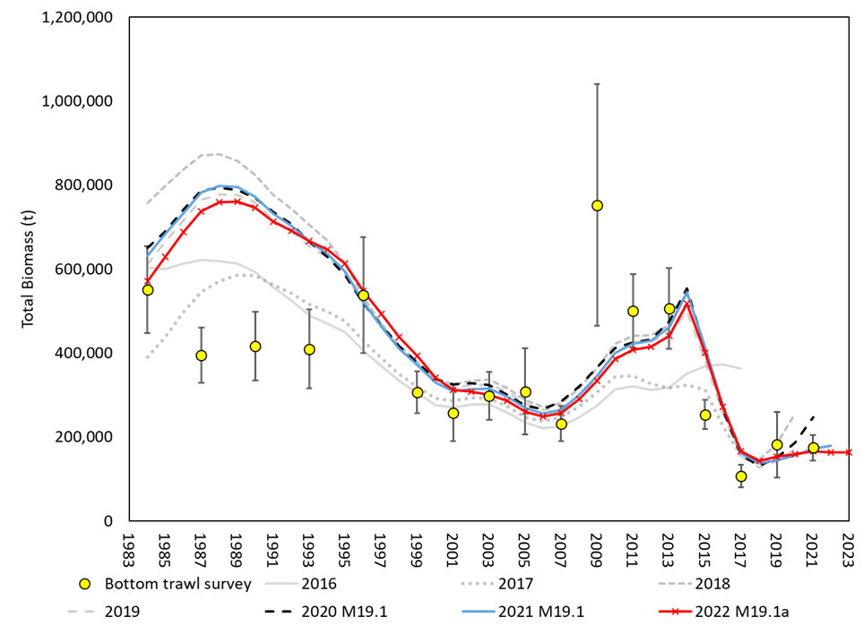
Model retrospective ‘fit’ to biomass variable across assessments
Slight downward turn in 2022 assessment
Results: data fits

Slide 25
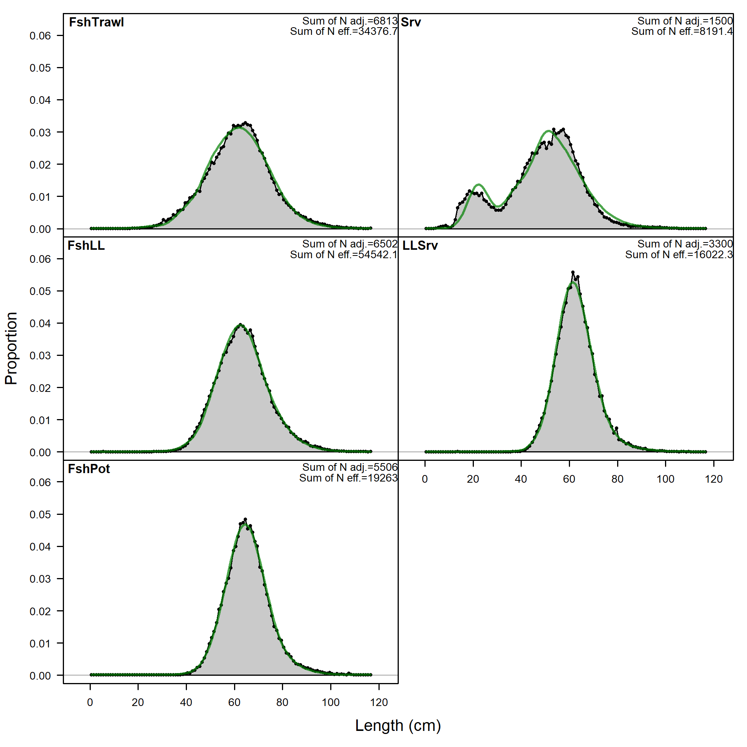
Results: data fits
In general, length comps fit well by model

Slide 26
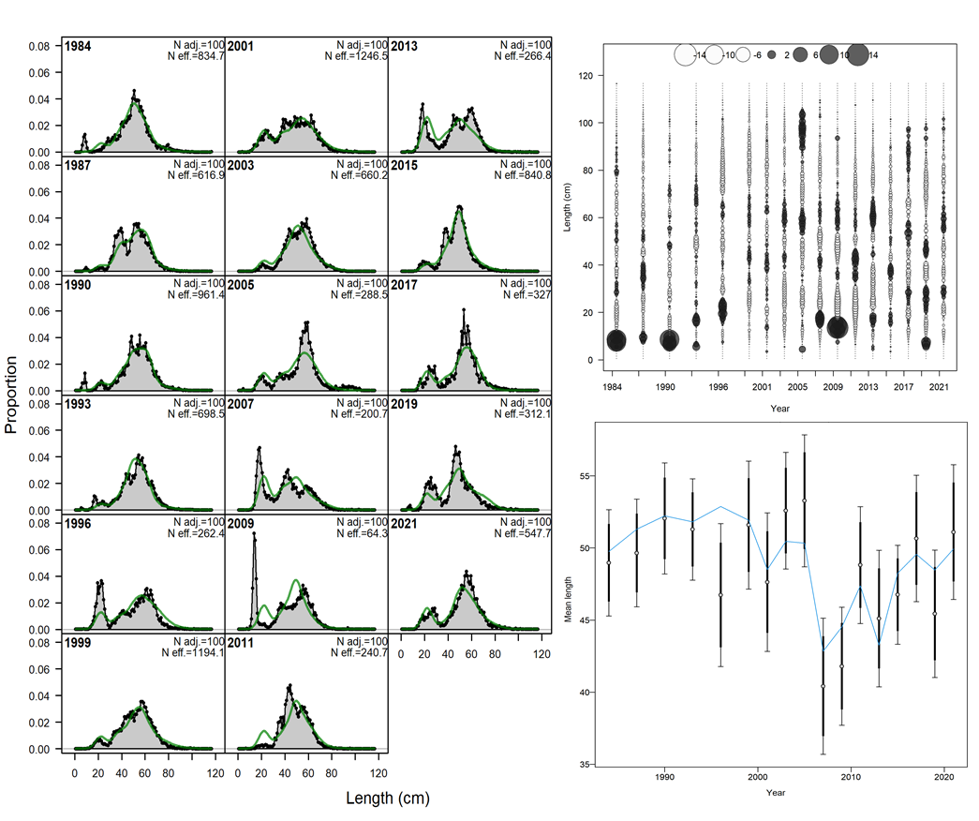
AFSC bottom trawl survey length comps

Slide 27
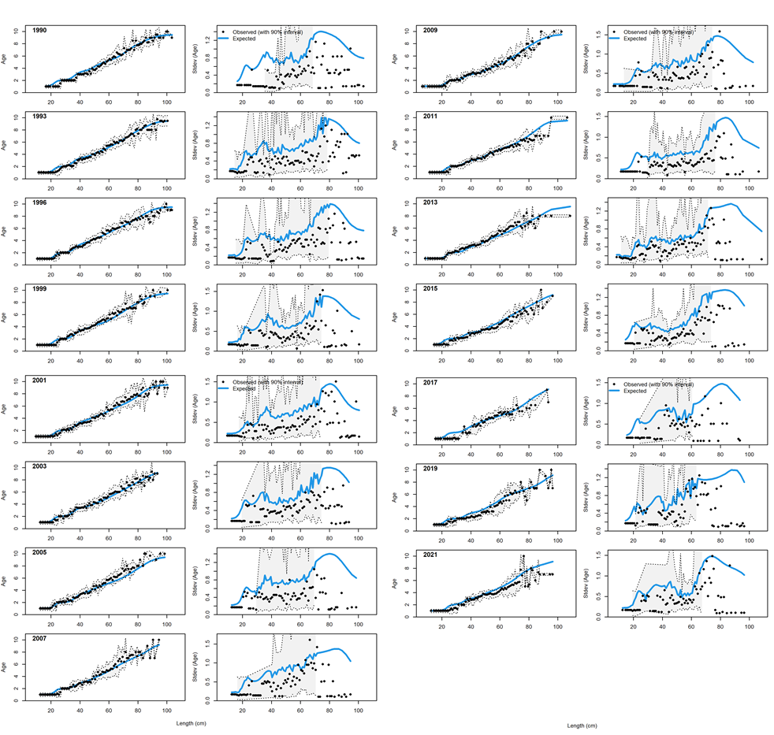
AFSC bottom trawl survey conditional age-at-length

Slide 28
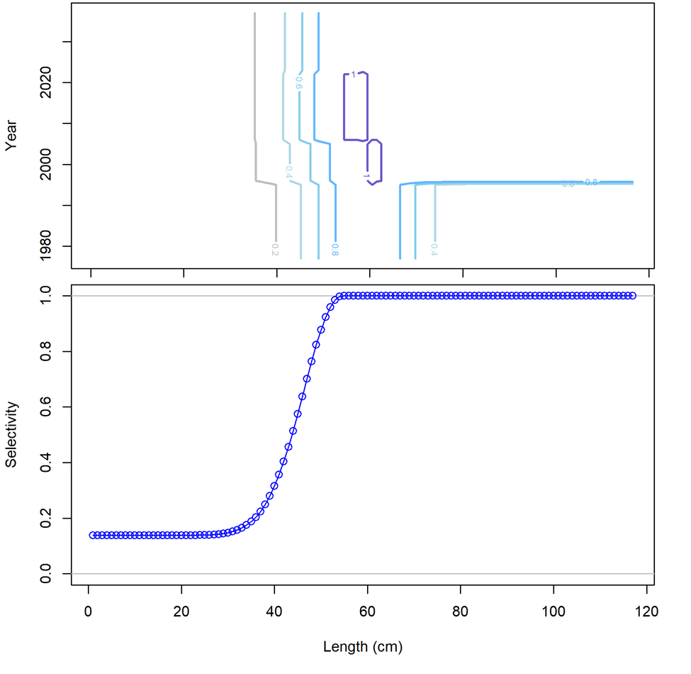
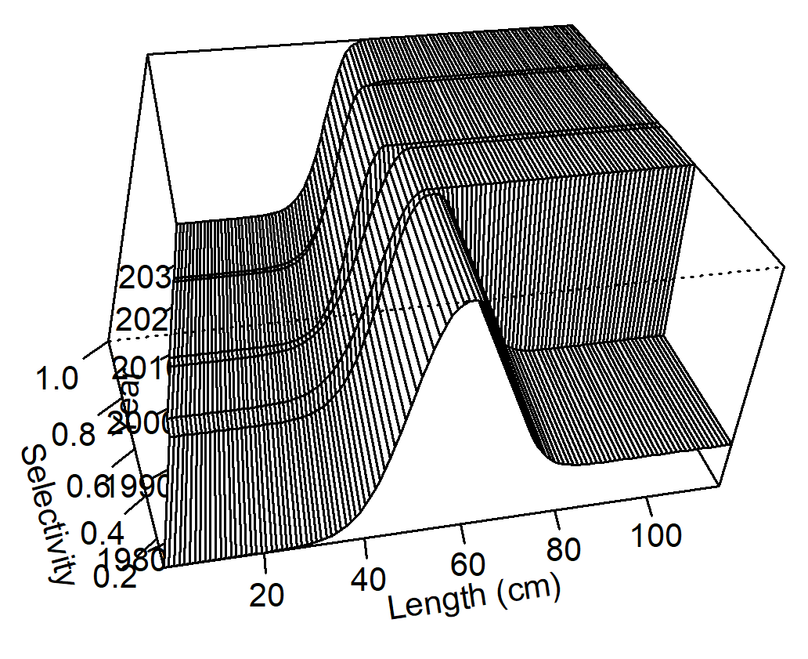
AFSC bottom trawl survey selectivity

Slide 29
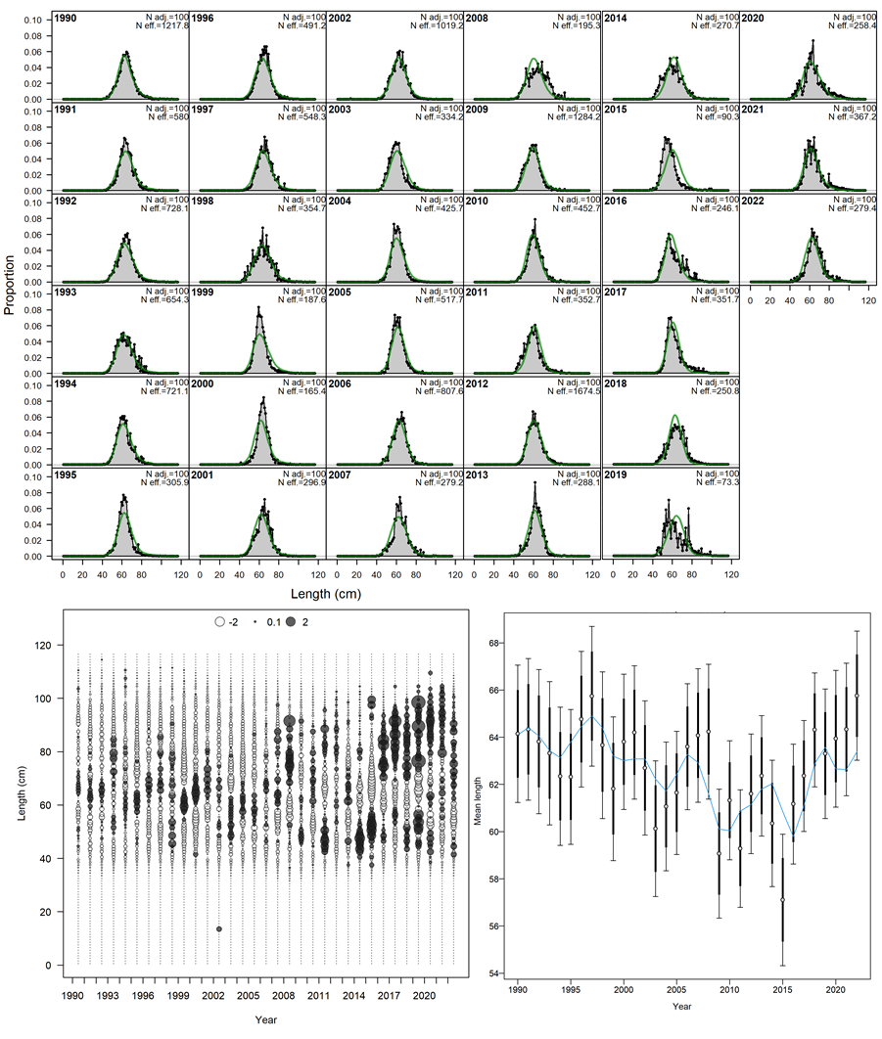
AFSC longline survey length comps

Slide 30
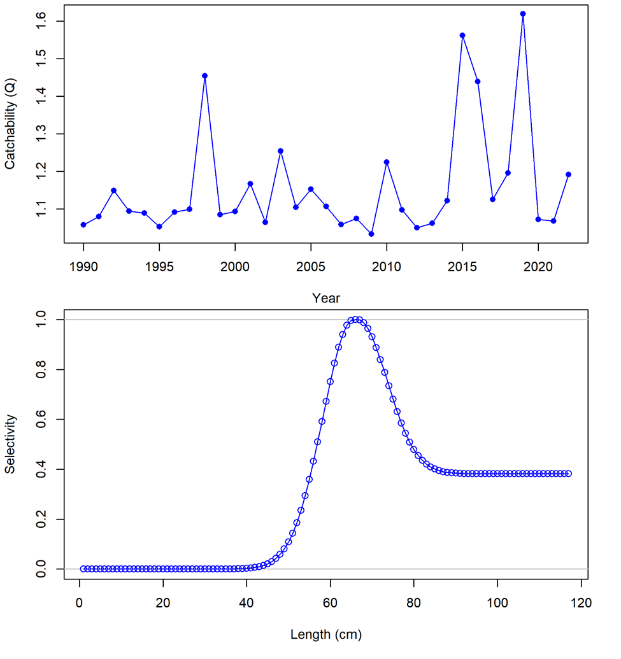
AFSC longline survey catchability and selectivity

Slide 31
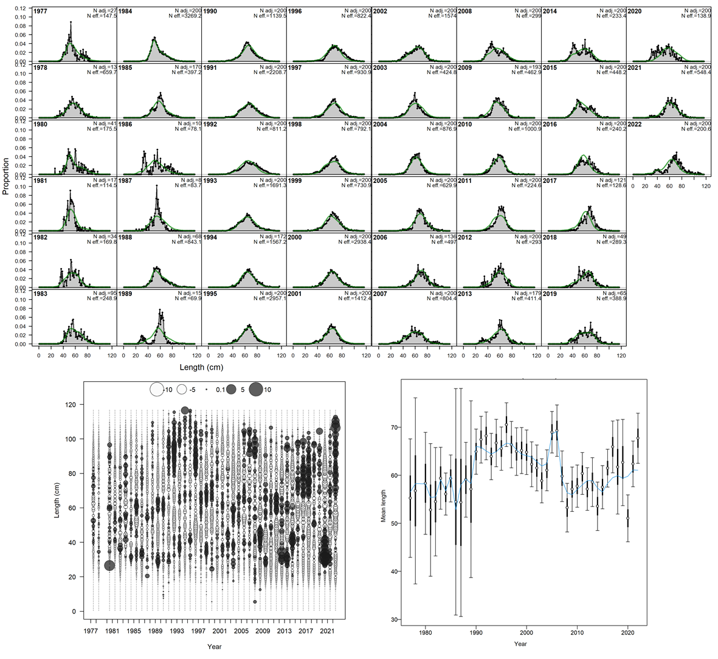
Trawl fishery length comps

Slide 32

Trawl fishery conditional age-at-length

Slide 33


Trawl fishery selectivity

Slide 34

Longline fishery length comps

Slide 35

Longline fishery conditional age-at-length

Slide 36


Longline fishery selectivity

Slide 37

Pot fishery length comps

Slide 38

Pot fishery condition age-at-length

Slide 39


Pot fishery selectivity

Slide 40


Model diagnostics:
Leave-one-out: 2022 influential, w/in that LL survey index on biomass, Trawl length comp on mortalities
Jitter: (CV of 0.05 and 50 runs) 45 of the 50 converged; 78% at MLE

Slide 41


Below average recruitment since 2014 (following a stanza of above avg recruitment)
Recruitment decreased across the board in the 2022 assessment compared to 2021

Slide 42

Results: parameter estimates
M decreased in 2022 assessment compared to 2021

Slide 43

Results: parameter estimates
F increased in 2022 for all fleets, Pot fleet continues to be primary source of mortality

Slide 44

Results: time series
SSB skipping along B_{20%}, projected to increase after 2024
Low recent recruitment estimates with precision, projected average recruitment larger than recent recruitments

Slide 45


Results: retrospectives
Low recent SSB retrospective pattern in both model and data

Slide 46


Large positive retrospective pattern in recruitment: continues to decrease year-class strength as data added

Slide 47
Results - summary
Model fitting bottom trawl, consistently expecting larger RPNs than what has been observed
Fitting comp data relatively well, not fitting increase in mean length
Conditional age-at-length fit degrading with new data
Estimating below average year-class strength since 2014
Large retrospective pattern in estimated year-class strength, continues to decrease with each assessment
Projecting spawning biomass to decrease through 2024, then increase (if average recruitment realized from 2022 on)

Slide 48


Stock status
Tier 3b: on the ramp
Moving down the ramp from 22 to 24
Estimated to be above B_{20%} (dashed red line), 2023 = B_{25.5%}
Projected to decrease to B_{24%} in 2024

Slide 49



Risk table
Assessment considerations:
Positive residual pattern in Longline survey RPNs
Below average recruitment estimated in last 7 years, and has undesirable retrospective pattern
Projected average recruitment hasn’t been estimated since 2013
Mid- to long-term outlook of stock sensitive to recruitment assumptions used in projections
Due to these concerns: Level 2
1977 on
2010 on
2014 on
 | Status quo | 2010 on | 2014 on
2023 ABC | 24,634 | 23,263 | 22,177

Slide 50
Risk table
Pop dy considerations:
Persistently low spawning biomass
Persistently low recruitment
Level 2
Environmental/ecosystem considerations:
Conditions have improved compared to recent past
Level 1
Fishery performance:
Basin effect occurring?
Will look at spatial constriction of catch
Level 1

Slide 51
Risk table
Assessment-related considerations | Population dynamics considerations | Environmental/ecosystem considerations | Fishery Performance
Level 2: Substantially increased concern | Level 2: Substantially increased concern | Level 1: Normal | Level 1: Normal
Overall:
No recommendations to reduce from maxABC
But, will continue to monitor assessment and population dynamics considerations

Slide 52
recommendations
Recommend Model 19.1a for 2023: 24% reduction in 2023 ABC compared to 2022

Slide 53

apportionment
No new data, no change to apportionment

Slide 54
Future work
Take another look at fit to longline survey
Pick up and investigate environmental link to growth again
Possibly look at 2 index REMA model for apportionment
Start having real conversations about how we use recruitment in projections and reference points

Slide 55
Questions?

